Slide 1
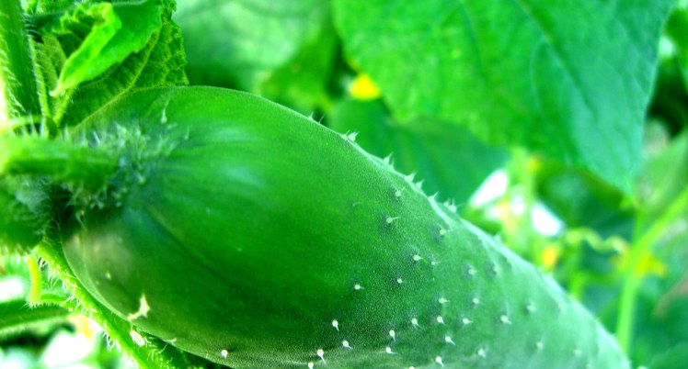
Growing Next Generation Leaders
2017 Gardens Summit
February 18, 2017

Slide 2
Introductions
Jill Schneider, Troy Community Gardens
Mark Wetter, Reindahl Community Garden
Notes:
Introduce ourselves

Slide 3
Garden Leadership Structure
One leader or coordinator?
Multiple leaders?
Notes:
REFER THEM TO THE HANDOUT IN THEIR FOLDER
First, let’s talk about how your garden leadership is structured.
Is it basically one person who does everything?
Do you have a group of people specializing in different areas: equipment, water, treasurer, etc.
Let’s look at the advantages of each type of structure….

Slide 4
Advantages of one leader
One person keeps track of all the details, particularly important from spring registration through opening day
One person knows the idiosyncrasies of gardener population
Sometimes it just easier to do it yourself
Notes:
Go through items on slide

Slide 5
Advantages of multiple leaders
Many hands make light work
Less risk if leader departs suddenly
Builds community among gardeners
Leading by committee takes the burden off of one person, particularly for difficult decisions
Notes:
Go through items on slide.
After reading off the items on the slide:
So if your garden has the “single person” leadership structure at this time and that person is interested in transitioning out or even if they aren’t at this time, consider having multiple leaders and split up the duties by functional area to take some of the load off of a single person.
That’s not to say you won’t want to have one person serving as “coordinator” to offer some continuity between functional areas, but with busy schedules, it’s often impossible to find one person with enough time to handle all the duties.

Slide 6
Break up the work for multiple leaders
By time of year or functional area. For example,
  getting ready for spring registration;
  plot assignment work;
  getting ready for opening day;
  plot monitoring;
  work days
Notes:
Good examples of functional areas are plot monitoring or running work days. Depending on the size of your garden, you could have anywhere from a couple leaders to multiple leaders in charge of plot monitoring and running work days.
You can also break up tasks typically done in late winter and throughout the spring by chunks of time.
For example, prepping for spring registration. In January and February, you are getting your application ready, getting your website updated, notifying gardeners of spring registration meeting or application deadlines; contacting gardeners on the waiting list, etc.
Likewise, plot assignment typically takes place between spring registration and opening day. This could be another set of volunteers with oversight by the coordinator.
Then there is typically a set of tasks to get done leading up to Opening Day (e.g., plowing, marking plots, updating spreadsheet or database with new gardener information).

Slide 7
Recruiting new leaders
Document everything you do in detail
Alert people well ahead of time
Start recruiting early
Tap gardeners who already participate
Make direct contact by calling (emailing doesn’t work)
Recruit more than one person
Notes:
How do you recruit new leaders? Well before you even do that, make sure you document everything in detail for the entire season. No detail is too small, especially if that one person who has done everything in the past leaves suddenly.
Alert the garden community well ahead of time and start recruiting earlier than you think you’ll need to.
Go through other items on slide.

Slide 8
What to look for in a leader
Good people skills
Good organizational skills
Time!
Thick skin ☺
Computer skills
Patience, patience, patience!
Ability to respond in a timely manner to email, texting and phone calls
Notes:
And, when you’re deciding who might make a good leader at your garden, consider the following:
Highlight some items on slide

Slide 9
Transition Period
Start at the beginning of the year
Mentor entire season; stay available following year for questions
Meet on a regular basis and share your task list
Be flexible; your way may not be the best way
Copy them on all your email communication
Give them access to your gardens’ email address
Notes:
Here is some advice for the transition period:
Go through items on slide.
Emphasize mentoring at least for a season and staying available during the next year if possible.

Slide 10
Garden Records/Documentation
Store electronic files in the “cloud”
  Reduces risk of having files on just your home computer
  New leaders can view and eventually update the files
Share login credentials for website and PayPal
Share paper-only records and make copies to store separately
Notes:
You will need to share records and your documentation with others during the transition period. Even if you aren’t transitioning to new leadership, it’s a good idea to follow these practices.
A convenient way to make documents available to more than one person is to store them in a cloud-based service such as Box or Google Drive. This removes the risk of having records on one computer.
If cloud-based storage isn’t an option, be sure to back up electronic records regularly and store back up at another location.
You’re going to have to share login credentials for your garden’s website and any PayPal accounts associated with online registration.
If your records are completely paper based, make copies of your paper records and store in a separate location.

Slide 11
Examples of Documentation/Records
Gardener information stored in electronic format or on paper
Task list of everything you do throughout the season
List of critical contacts (e.g., plowing, hay orders, etc.)
Plot application
Plot map
Regular communication templates (e.g., post cards, email templates)
Volunteer hour tracking spreadsheet
Waiting list
Garden meeting minutes or notes
Notes:
Here are some examples of items that you will need to be made available to new leadership.
Refer to slide

Slide 12
What about financials?
Consider having a separate treasurer
Make sure you have checks and balances or audit trail
Share checking account, debit card, PayPal account information
Give and keep receipts for cash transactions
Notes:
Here are some typical financial related items to consider, especially if you’ve had one person handling everything in the past.
See list on slide

Slide 13
Advice for Outgoing and Incoming Leaders
Outgoing
  If you continue to garden, you need to wean gardeners away from you and to the new leaders. Be polite and know it may take a while.
  Be supportive of new leadership
Incoming
  Have a notebook in your garden bag to document conversations with gardeners
  Consider parking car in a hidden location when at the gardens
  Network with other garden leaders by joining the Gardens Coalition
Notes:
Transitioning to new leadership is going to take time, ideally an entire season. Here is some advice for those leaving and those coming into leadership roles.
See items on slide.

Slide 14
Rewards of becoming a Garden Leader
Easy to get your volunteer hours done
Get to interact with a wide variety of people and improve your ‘people’ skills
Skills acquired are transferrable to other volunteer or work positions
First dibs on stuff left in plots ☺
Come to Summit each year
Notes:
And, don’t forget, there are rewards to being a garden leader!

Slide 15
What are your experiences with leadership transition?
Who has been through a transition?
What worked for you?

