Slide 1
Cultivating Successful Gardeners
GARDEN SUMMIT 2017
Gardens Network
Dane County and Madison, Wisconsin

Slide 2
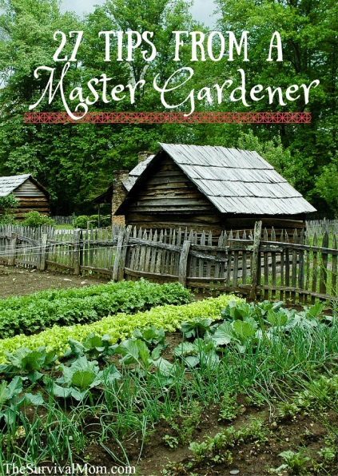
Begin a New Gardening Season
Provide orientation for returning and new gardeners
Distribute a Garden Handbook
Make plot assignments after orientation
Engage Master Gardeners & other mentors
Hold “How to Get Started” educational
sessions

Slide 3
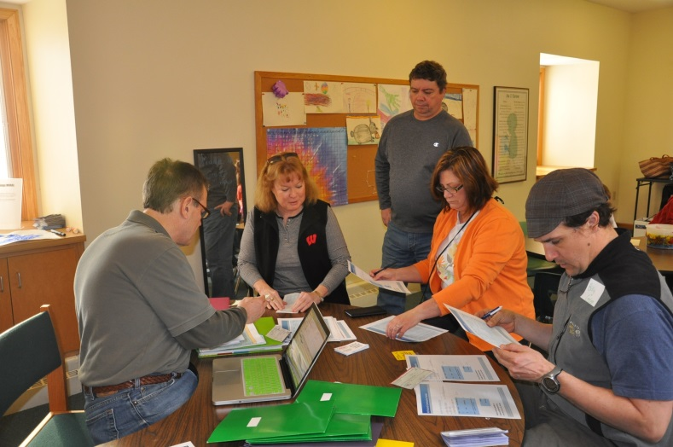
Orientation
Consider offering a number of orientation sessions at different days/times to accommodate schedules.
Use this time to:
  Review Handbook
  Take Supply Orders and Payments
  Collect Incomplete Registration or Demographic Forms
  Initiate Volunteer Sign Up Opportunities
  Educate Gardeners
  Offer Free Seeds

Slide 4
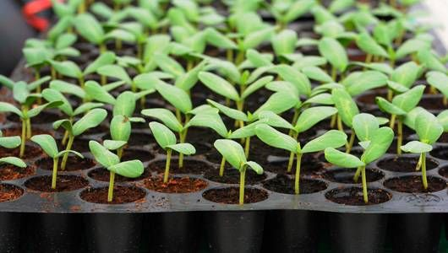
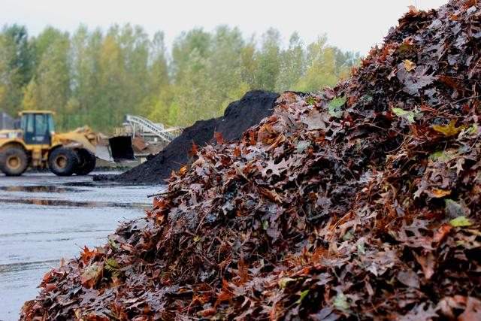
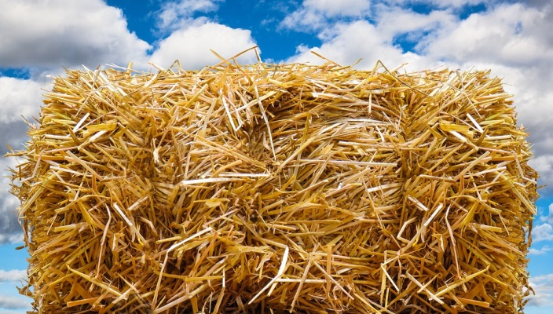
Order Garden Supplies
There are many available resources
Provide garden supply order forms
Engage area youth organizations – seedlings
Provide delivery and distribution

Slide 5
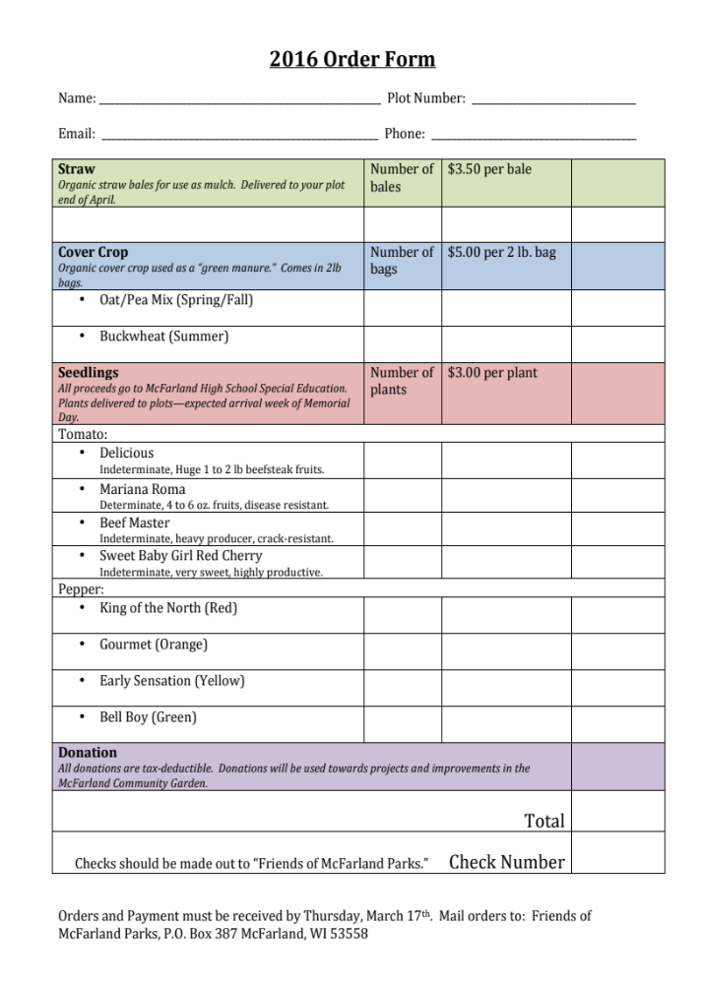
Consolidated Order Form
All supply orders on one form
List the scheduled or expected date for delivery
Offer a Donation option...you may be surprised how many you will receive!

Slide 6
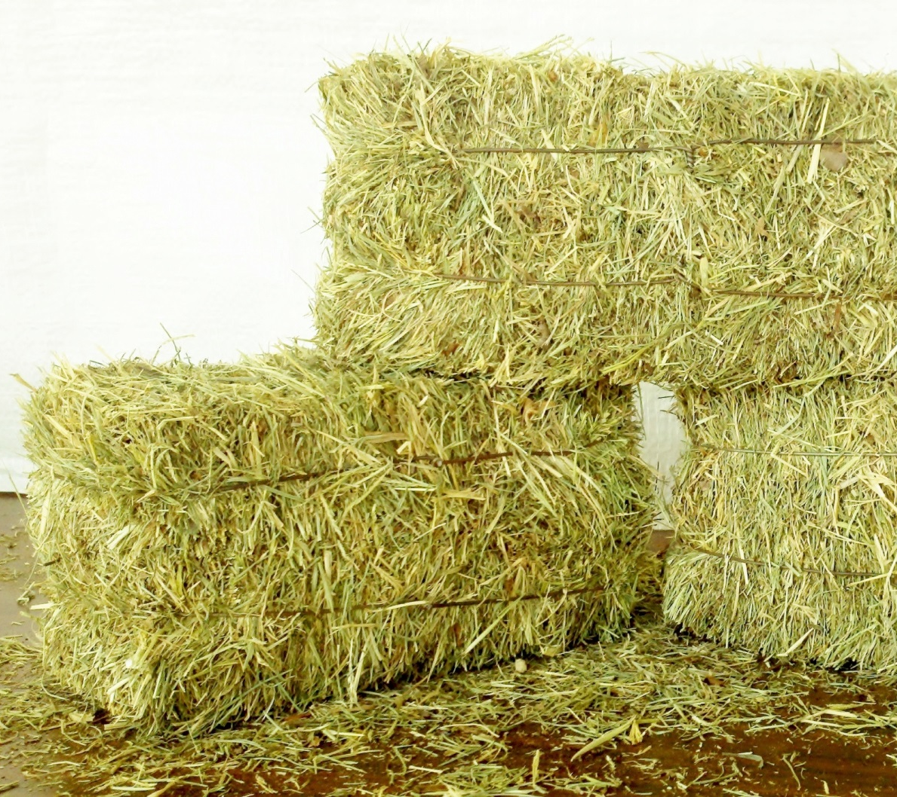
Straw and/or Hay Mulch
Retains soil moisture
Deters weed growth
Biodegrades for increased soil fertility and improved soil structure.

Slide 7
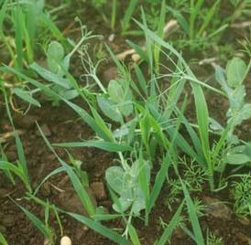
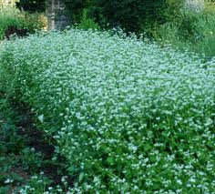
Cover Crops
Oats & Peas
(Spring & Fall)
Buckwheat
(Summer)

Slide 8
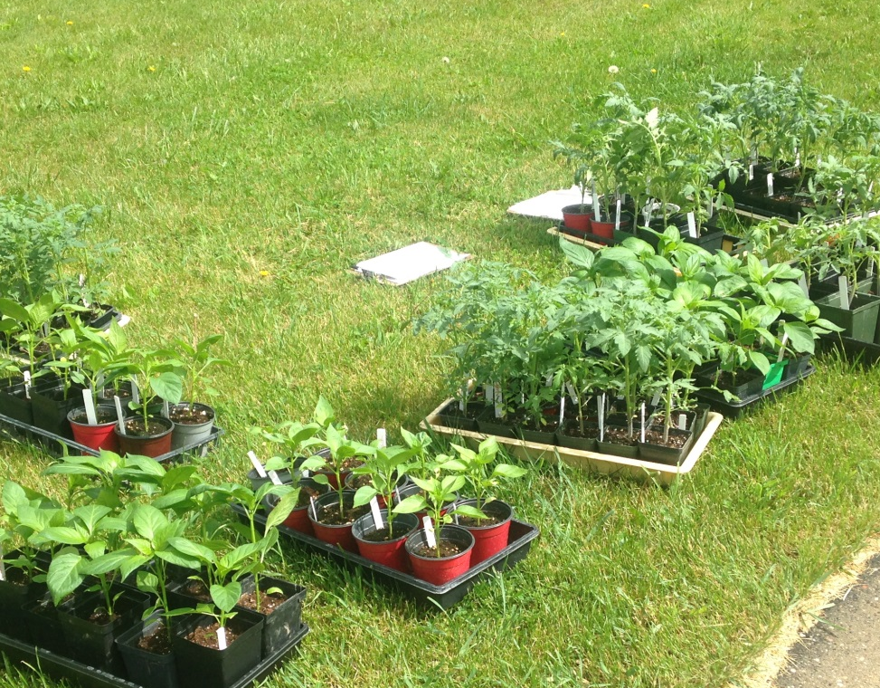
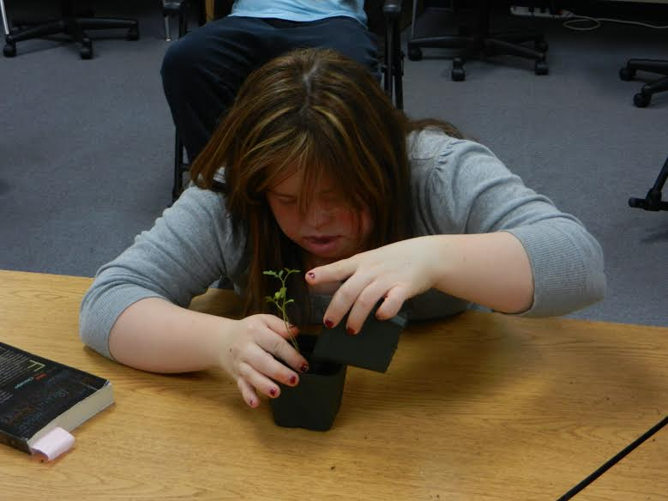
Partner with Schools or Community Organizations
Pick a variety of seedlings that are easy to grow, disease resistant, and well suited to Wisconsin gardens.
Seedling sale with McFarland High School Special Education Department

Slide 9
Organize a Strategic Planting Plan
Know when to plant – frost and soil temperature
  Average last day of spring frost: April 26 – May 2
  Spring plants – 45F soil temperature
  Summer plants – 60F soil temperature
Start seeds indoors based on spring frost date
Consider days to maturity and harvest cycle
Select healthy, disease resistant plants
Improve your soil

Slide 10
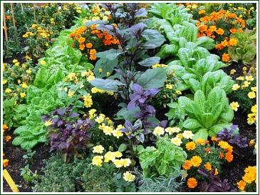
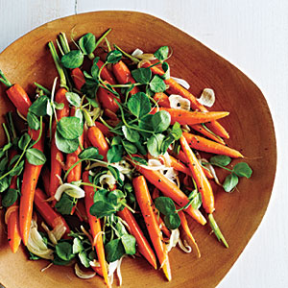
Companion Planting works!
Plant location and spacing – support over time
Plant selection – attract pollinators or ward off pests
Plant selection – not competing for nutrients
Target plants – selection and timing

Slide 11
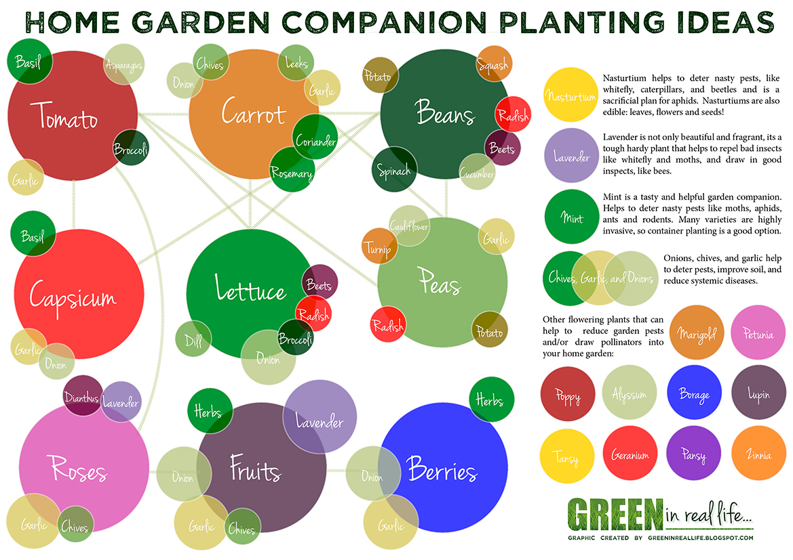

Slide 12
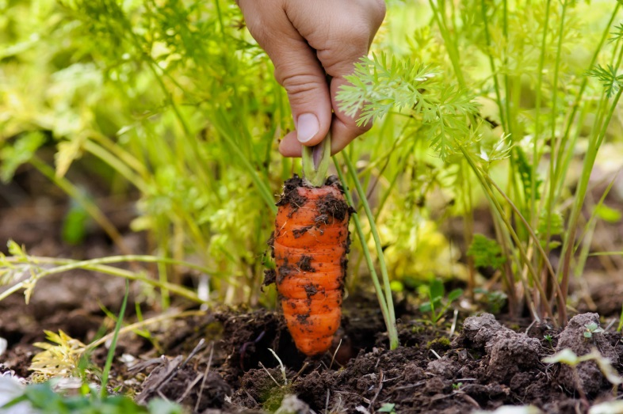
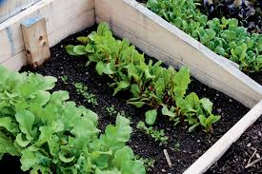
Succession Planting Tips & Timing
Over seed and thin by harvesting – beets, carrots
Infill after early harvests – beans after spinach
Repeat spring plantings in late summer
Begin seeds prior to planting in the garden

Slide 13
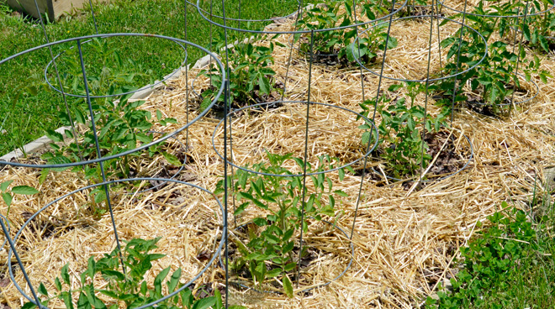
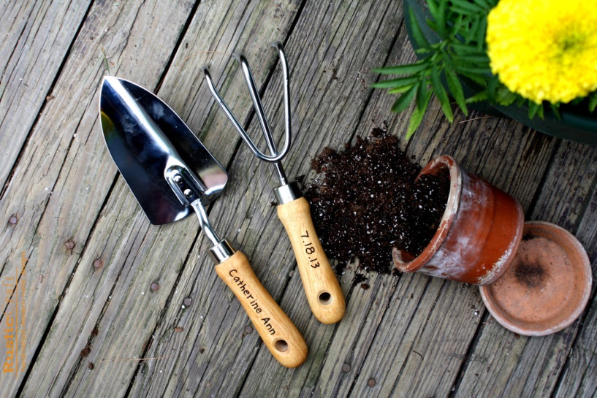
Mechanical Controls for Disease Prevention
Plant rotation
Cover crops improve soil
Ground cover
Selective pruning
Garden tool cleaning
Garden refuse maintenance and compost
Plant spacing for air circulation

Slide 14

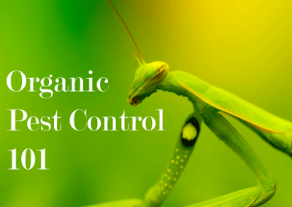
Use Organic Controls for Pests and Disease as needed
Time plantings around the growth cycles of pests
Construct physical barriers at base of plant
Large colonies attract beneficial predators
Mechanically remove pests by hand picking
Insecticidal soaps
Diatomaceous earth
Biological deterrents – bacteria
Pyrethrum
Others as approved by
UW-Extension

Slide 15

Build a Sense of Community
Publish a Garden Newsletter
“Help Needed” requests
Hold Educational Sessions
City of Madison Flower Program
Establish a Garden Library
Connect with Neighborhood

Slide 16
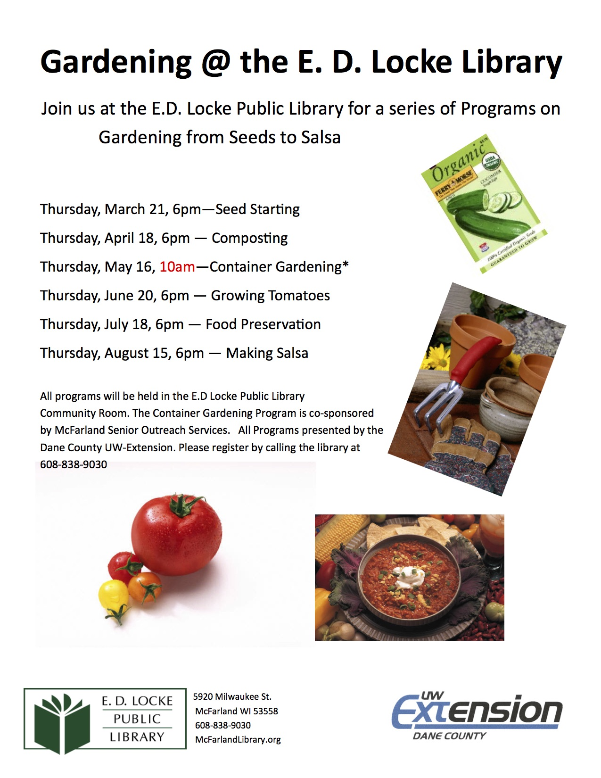
Reach out to your local library branch to arrange for workshops. UW Extension will partner with libraries and community organizations to offer a wide range of programming.

Slide 18
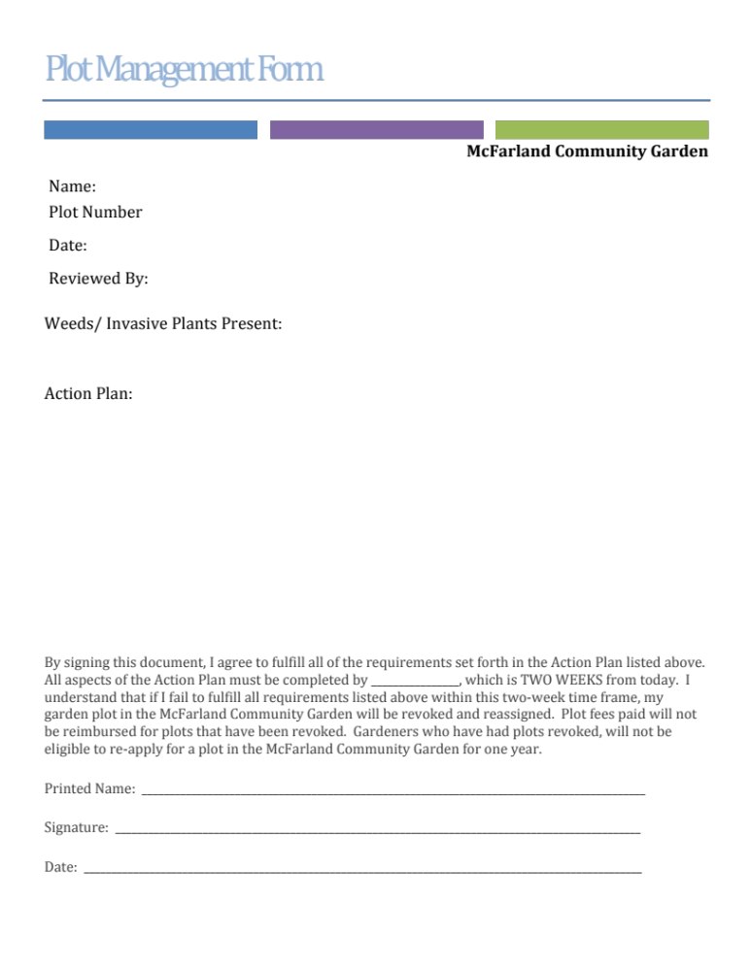

Gardeners Need Help or Guidance? Connect with Master Gardeners!

Slide 19
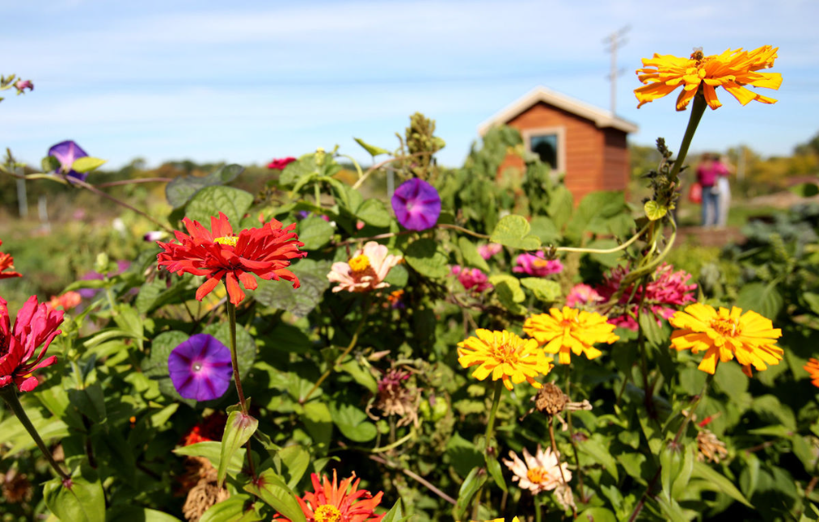
Encourage Interactions!
Identify gardener’s specific interests – pollinator garden, website, photography, etc. – invite participation
Schedule photo sessions of gardeners’ plantings and garden neighbors – highlight in newsletter and website
Reach out to community groups to engage with the garden
Hold a Garden Photo
contest with prizes

Slide 20
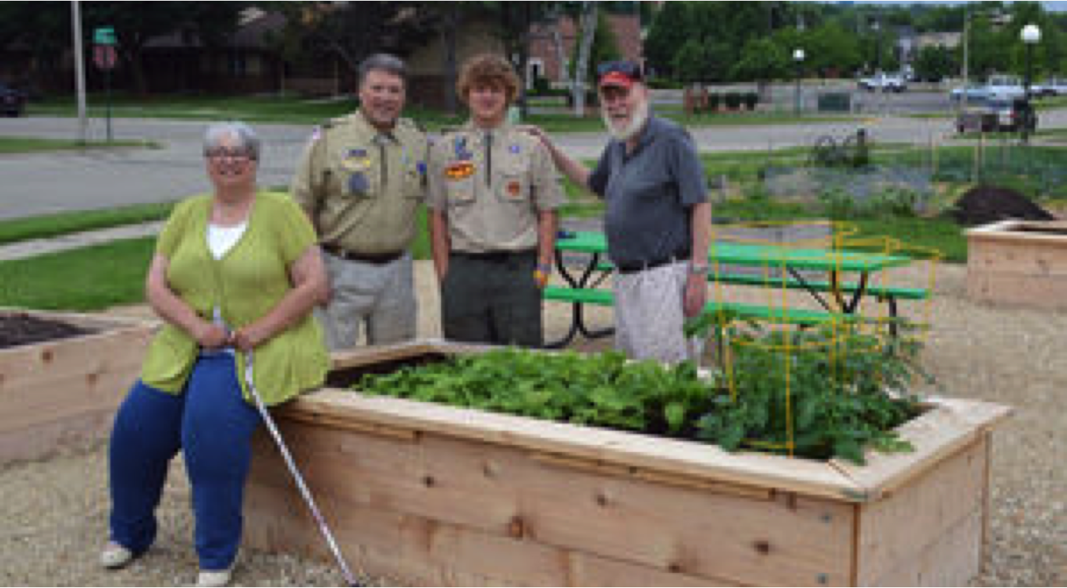
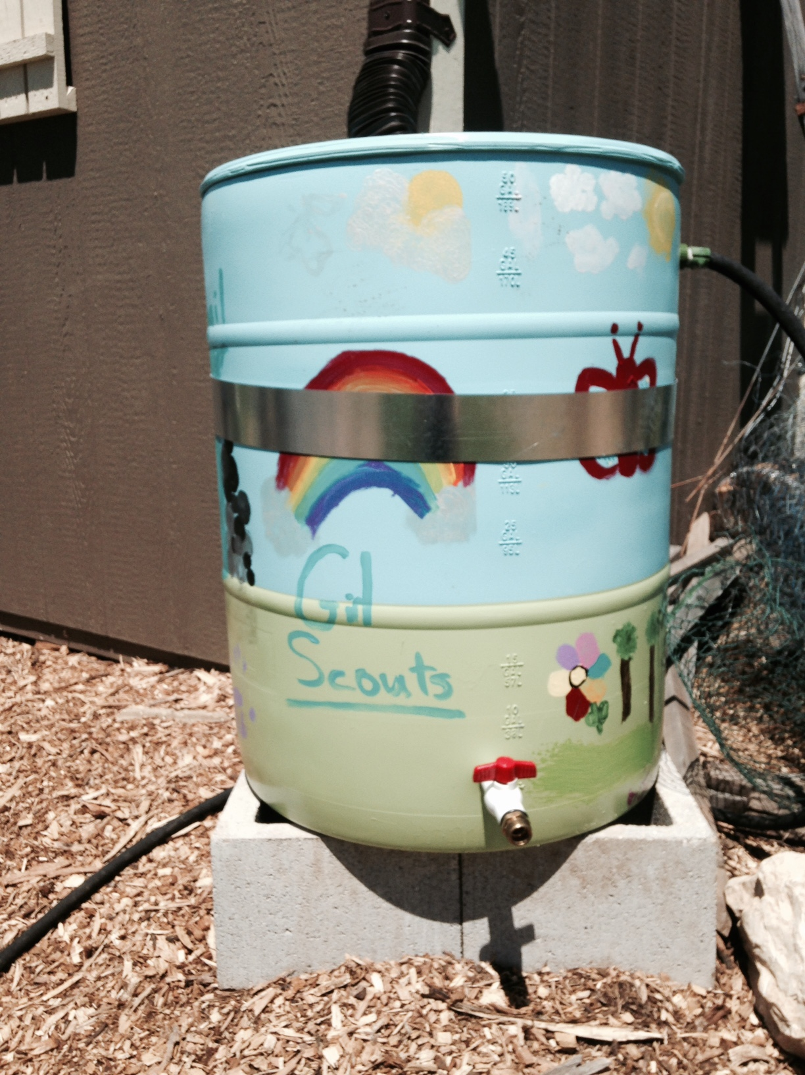
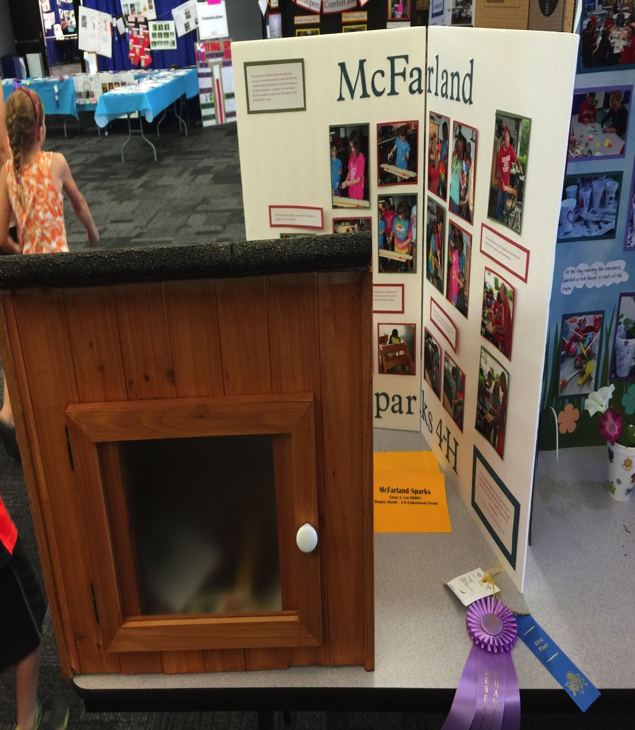
Foster Gardener Interests & Reach Out to Community Groups to Engage with the Garden

Slide 21
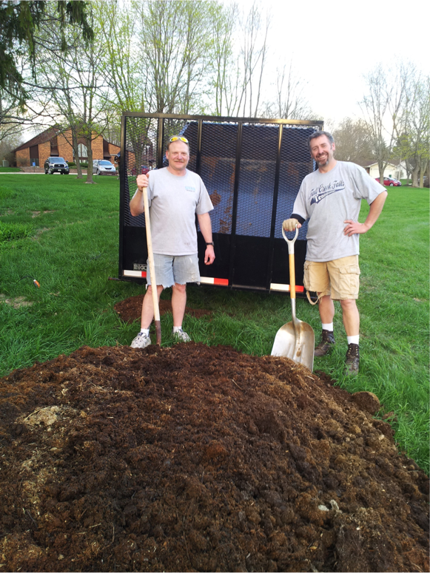

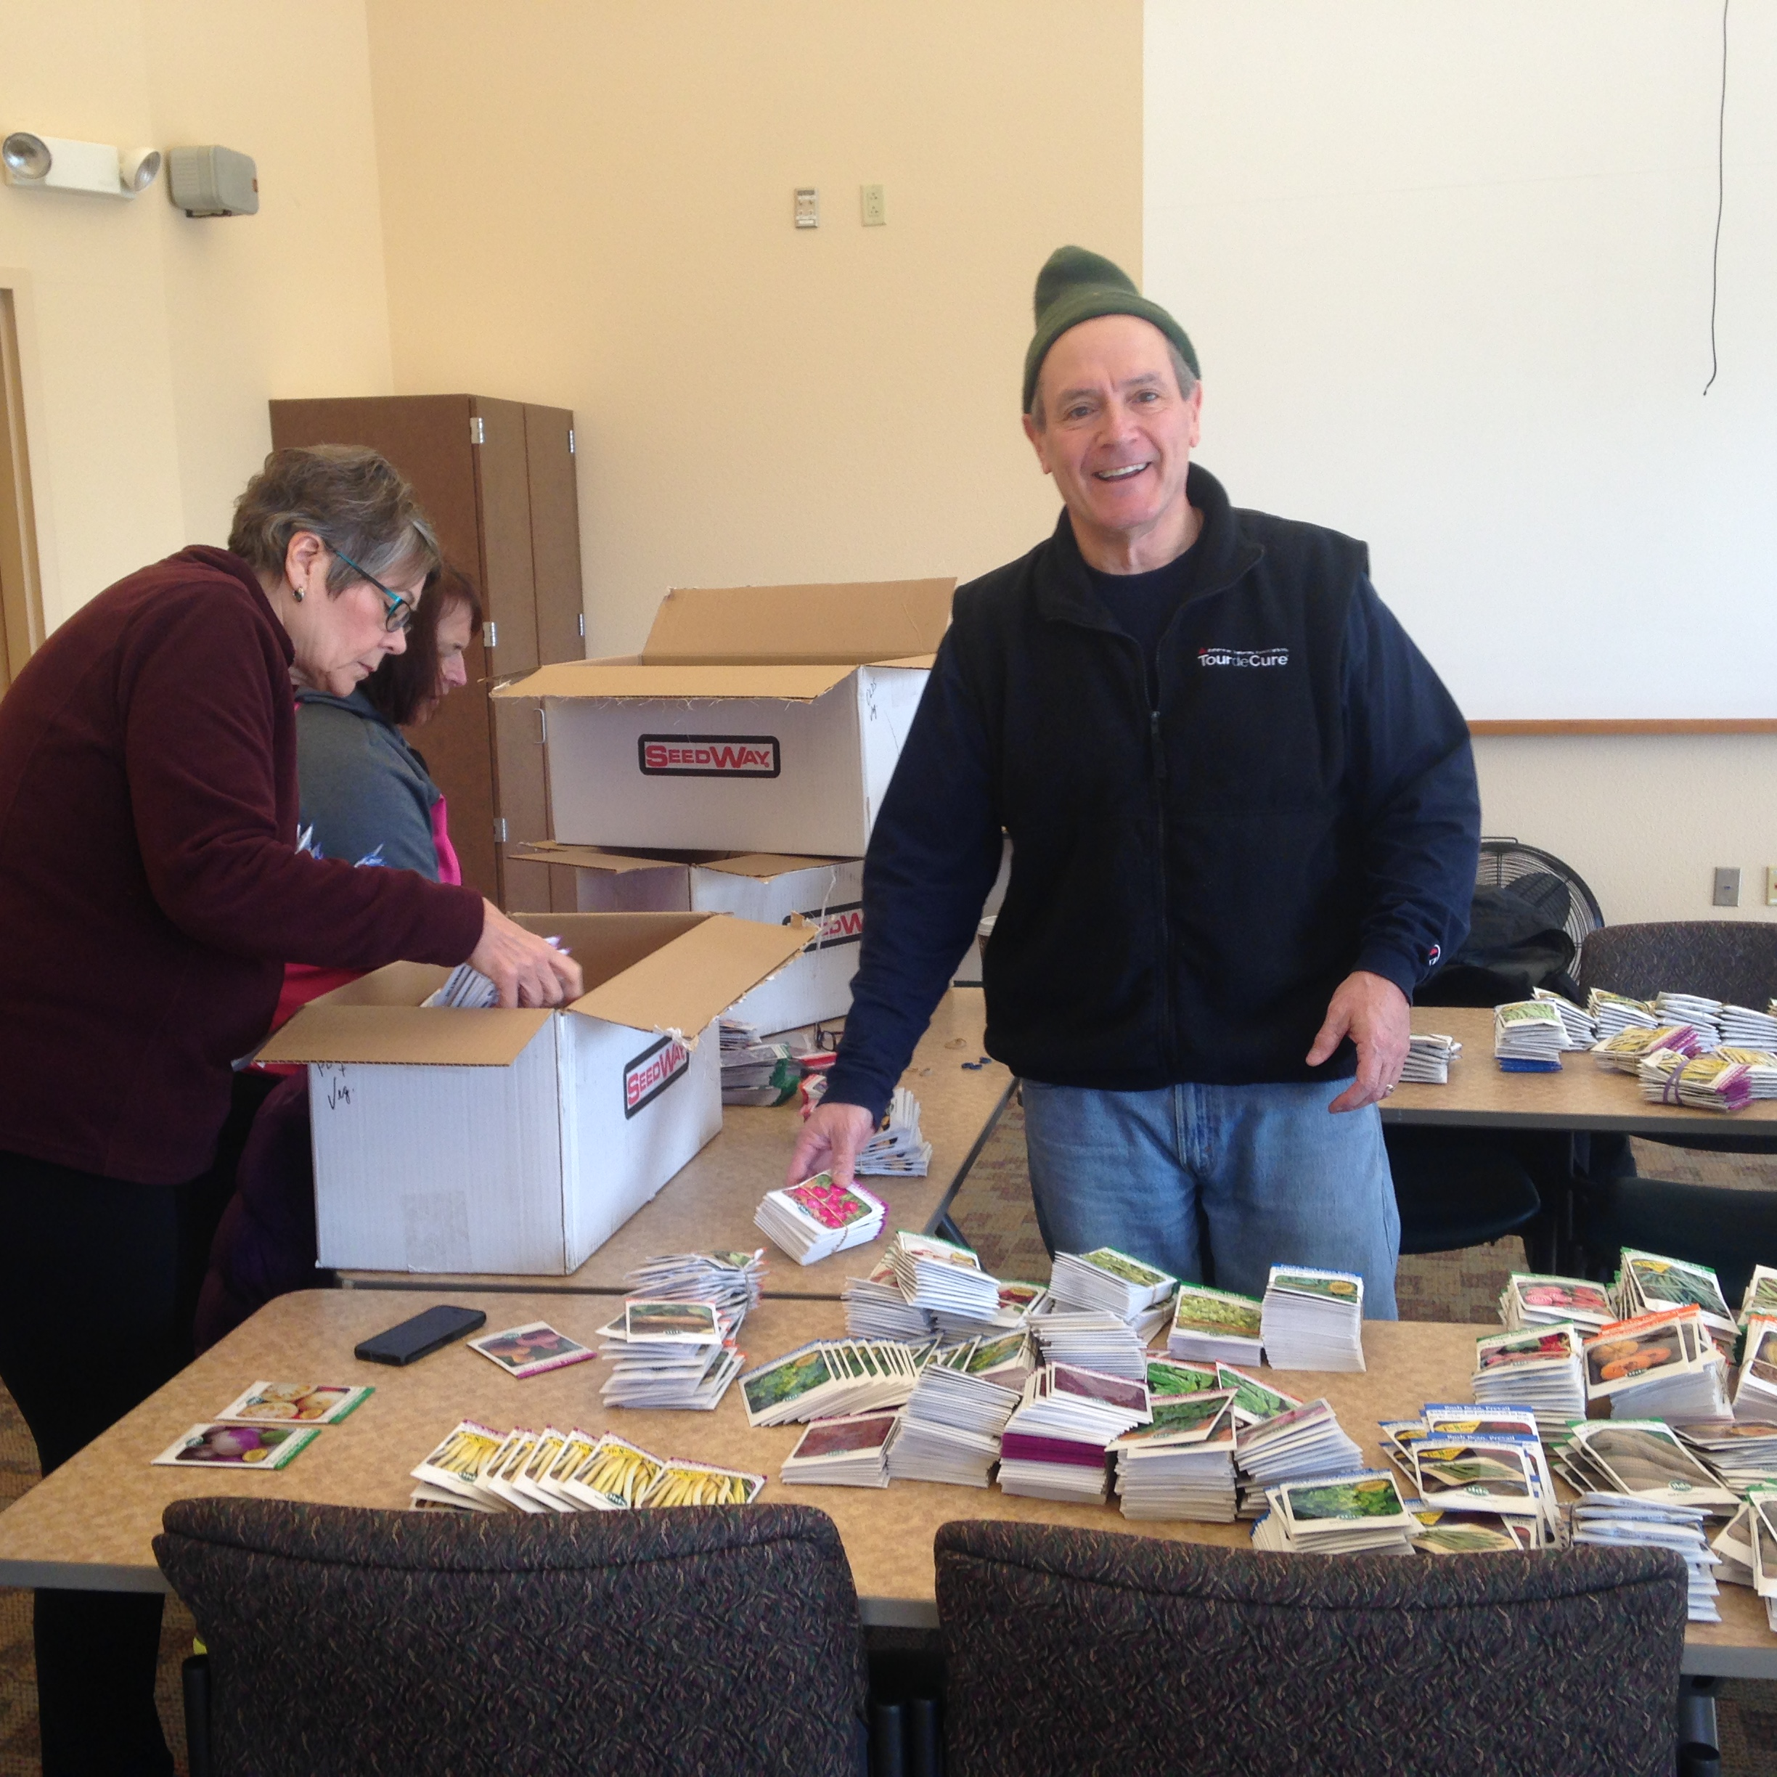

Slide 22
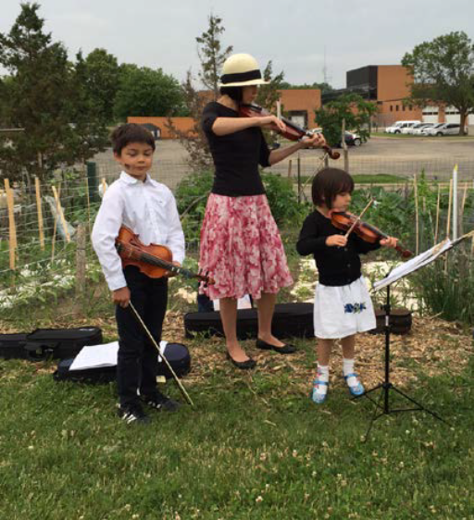
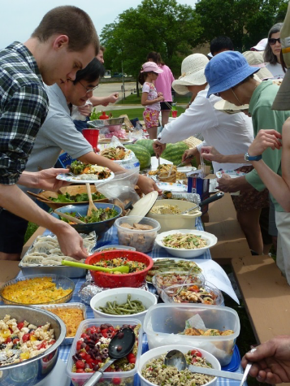
Offer Social Events
Annual spring and fall meetings
Solstice celebrations
Make Music Madison!
Garden Brunch – after work days
Open House – gardeners, neighbors, gardening advocates, etc.
Area school tours and volunteers

Slide 23

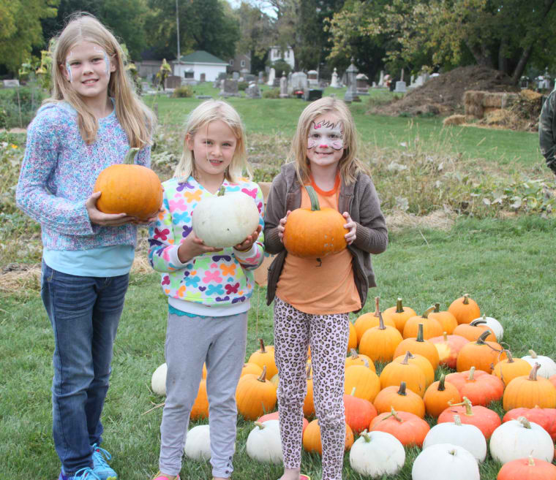
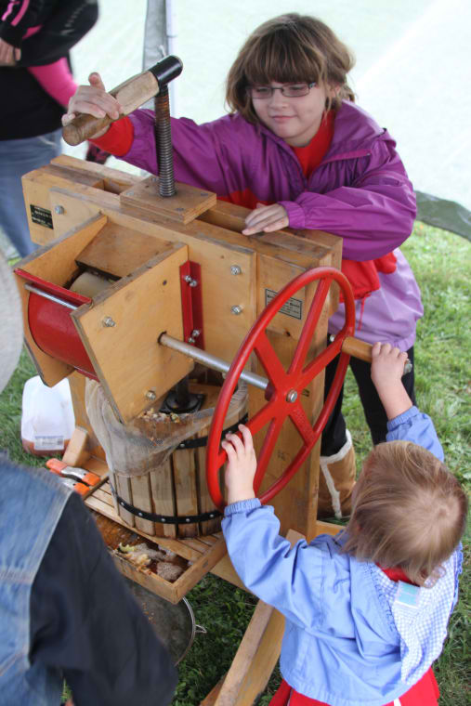

Slide 24
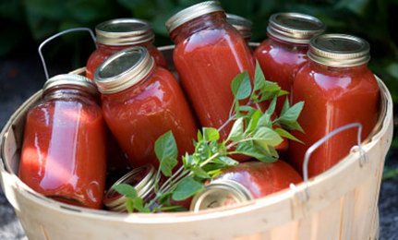
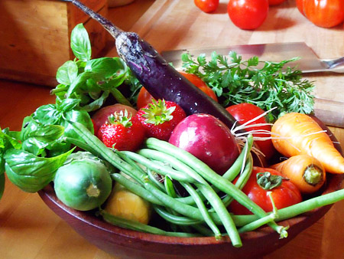
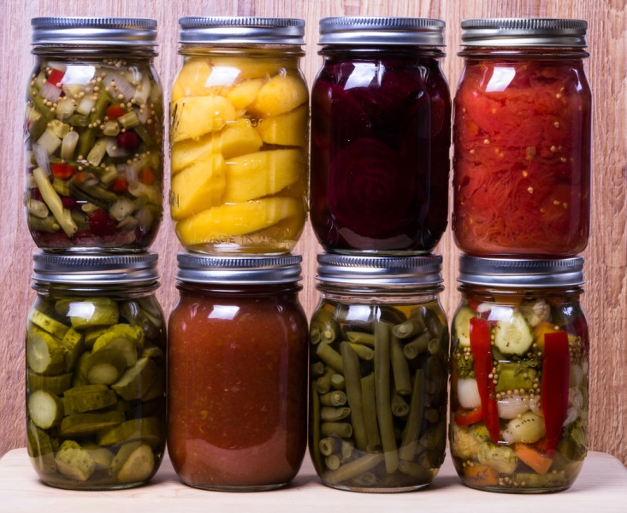
Harvest and Preserve
All season long
Workshops

Slide 25
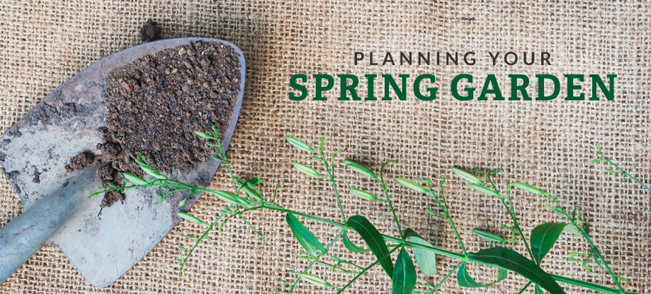
Celebrate a Successful Season
Fall meeting – all gardeners
Elections of new garden officers
Review of the season: what worked – what did not!
Suggestions for next year – equipment, communication

Slide 26
Questions?
Katie Gletty-Syoen
katiegs@gmail.com
Cindy Statz
coordinator@sheboygancommunitygarden.org
Note: Gardening resources abound. Many photos included in this presentation were selected online. Sources are available upon request.

