Slide 1
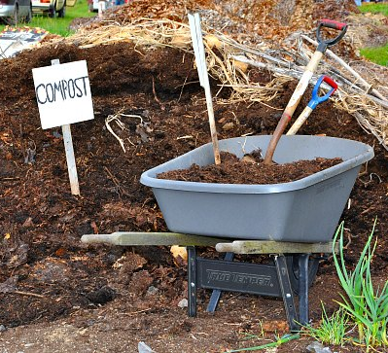
In Plot Composting
Garden Summit 2020

Slide 2
Controlling the natural process of decay to transform organic waste into a valuable soil amendment called compost.

Slide 3
Why compost?
Waste Management
Yard waste banned from landills
Encourages responsibility of your waste
Finished Compost
Valuable soil amendment
Healthy soil = healthy plants
Save $

Slide 4
Supplies organic matter
“Lightens” heavy soils
Improves moisture retention in sandy soils
Contain humus “soil glue”
Improves soil structure
Encourages root growth
Enables soils to retain nutrients
Buffers soil pH
Supplies beneficial microorganism
Feeds soil life

Slide 5
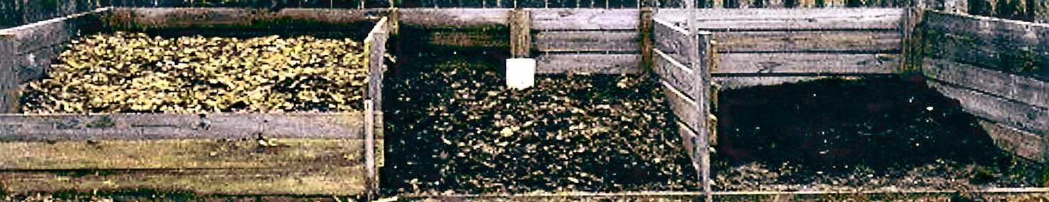
How is compost made?
Natural process:
Biological decomposition of organic matter in the presence of oxygen
Human influenced:
We can speed up or slow down the process
Notes:
Composting is nothing more than speeding up the natural decay process. A compost pile is used to manage the factors that affect the rate of decay.
These factors are: Air (oxygen), water, food and temperature. The quality of the resulting compost depends on how well you control these factors.

Slide 6

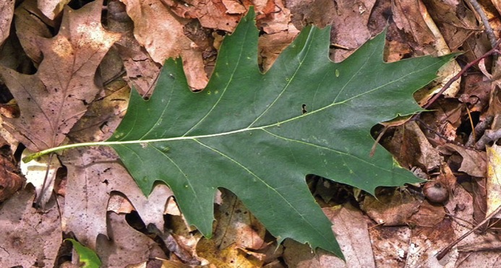
Microbes do the work
- Bacteria (including actinomycetes) and fungi
- Chemical decomposers – enzymes
- Found in:
Soil
Leaves
Food scraps
Manure
Finished
compost
Are compost starters needed?
Notes:
Within the compost pile we are trying to create conditions that are favorable for decay to occur. While we may see worms, beetles and bugs in our compost pile, the majority of the composting process is done by microscopic organisms such as bacteria and fungi. These naturally occurring organisms secrete enzymes which release energy that supports their life functions as well as heating up the compost pile.
Some garden centers and other retailers sell compost starters, inoculants or accelerators. They may in some cases help get the composting process started a little faster, however they are not necessary. Rapid composting can be achieved and high-quality compost can be produced without using these products.

Slide 7
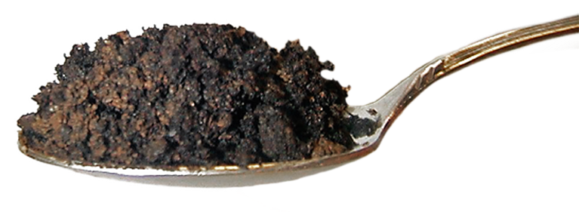
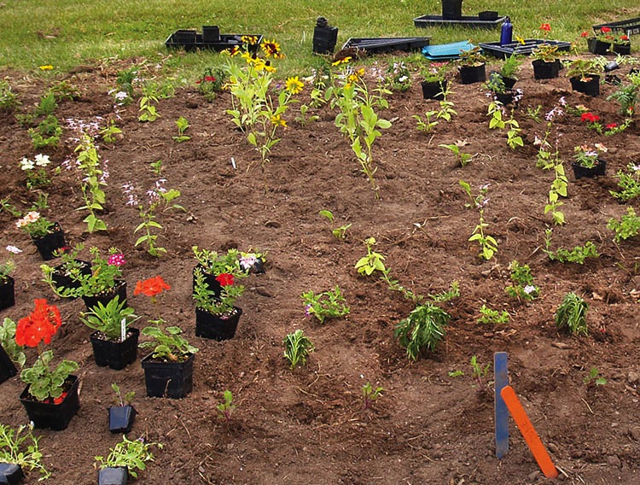
One teaspoon of good garden soil to which compost has been added may contain:
100 million bacteria
800 feet
of fungal
threads
Notes:
One source of organisms is your own garden soil. Small amounts of soil can be added to your compost pile to provide all the bacteria and fungi it needs to get fired up.
However you don’t need to add soil. Bacteria are all over leaves, grass and other yard materials you add to your pile. Just keep them happy and they will multiply and work for you.

Slide 8
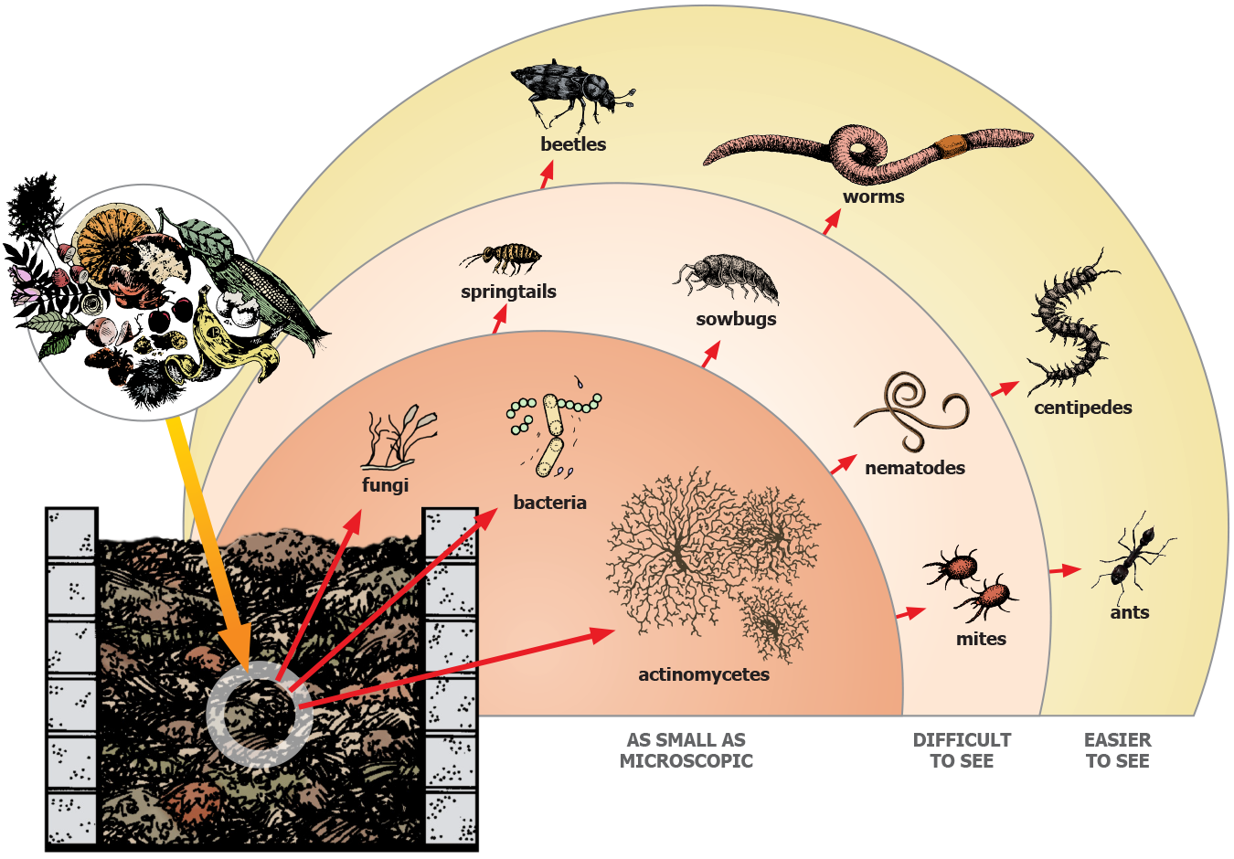
Macroorganisms
Notes:
In addition to microorganisms there are other living things in our compost pile. These macroorganisms return to the pile after pile temperatures drop. They are good indicators that the compost is continuing to break down. Look for earthworms, sow bugs, mites, springtails, beetles, millipedes, centipedes and even snails and slugs. While some of them may be feeding on the materials you have added to the pile, many are feeding on bacteria, fungi and other organisms in the pile. As a composter you have created the conditions for an entire ecosystem right in your back yard.

Slide 9
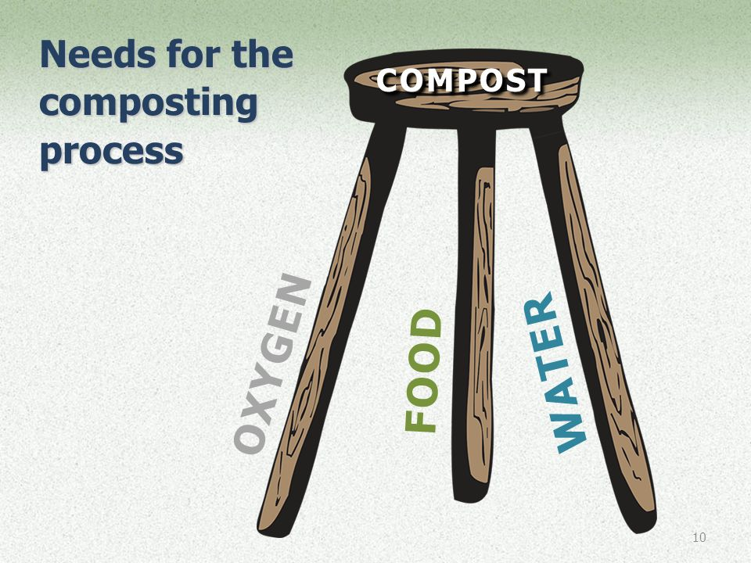

Slide 10
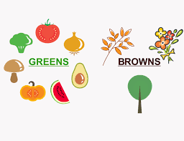
Food for compost
Leaves, grass clipings, yard debris
Kitchen scraps: vegetable and fruit peels, coffee grounds, egg shells
Used potting soil
Paper and cardboard
Most weeds and garden debris
Sawdust, hay, straw
Hair, fur, other natural fibers

Slide 11
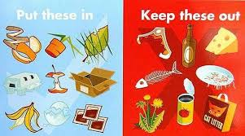
Compost pile “food” to avoid

Slide 12
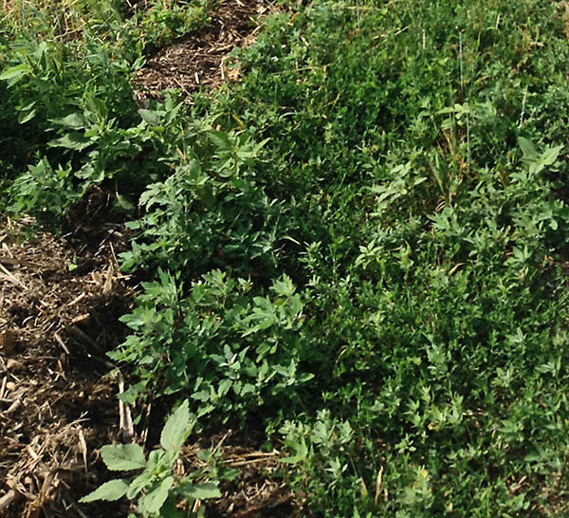
Plant materials treated with pesticides
Some pesticides can be persistent
Some survive the
composting process
Can damage other
plants
Notes:
Be careful when using pesticide-treated grass or weeds in your compost. It is best to leave treated clippings on a lawn for 3 or 4 cuttings after treatment. However, most pesticides break down in the composting process and the finished compost is good. But a few chemicals do not break down quickly. These residues, even in small amounts, can harm plants. One test is to grow pea seedlings in a compost soil mix. If the seedlings look normal with no distortion, twisting or mottling, the compost is likely safe to use. To learn what chemicals to avoid, contact your local Extension office or do an internet search on compost and pesticides.
Also, never use pesticide-treated grass clippings as mulch. The chemicals are active for a period of time after application and can kill or damage trees, shrubs or other plants.

Slide 13
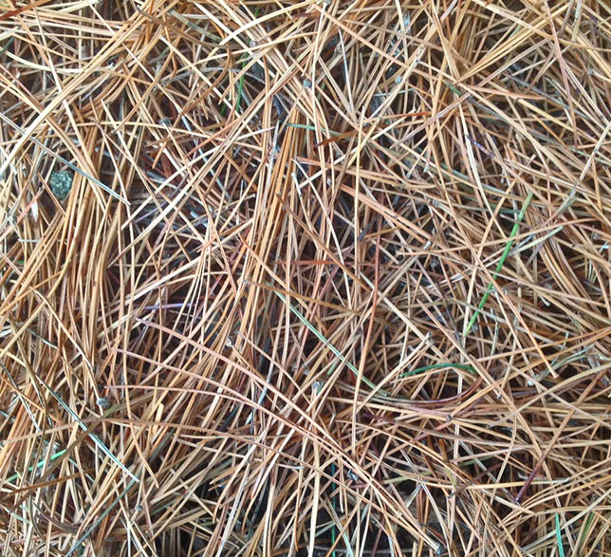
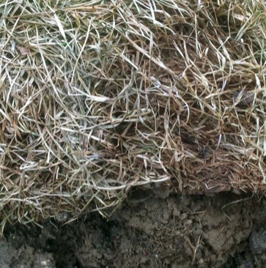
Materials with special needs
These require additional consideration or limited volume added
Pine needles
Walnut leaves
Sod
Notes:
Pine needles can be resistant to the composting process. Limit the amount of pine needles to 10 percent or less of the pile.
Black walnut trees produce a chemical called juglone which can adversely impact plant growth. Though research has shown that compost breaks down juglone, you may want to limit the amount of walnut leaves you add to your compost pile.
Sod can be slow to breakdown it is best placed at the base of a compost pile if added at all.

Slide 14
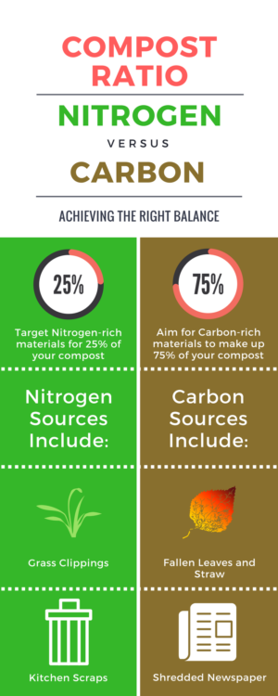
Organisms need a balanced diet

Slide 15
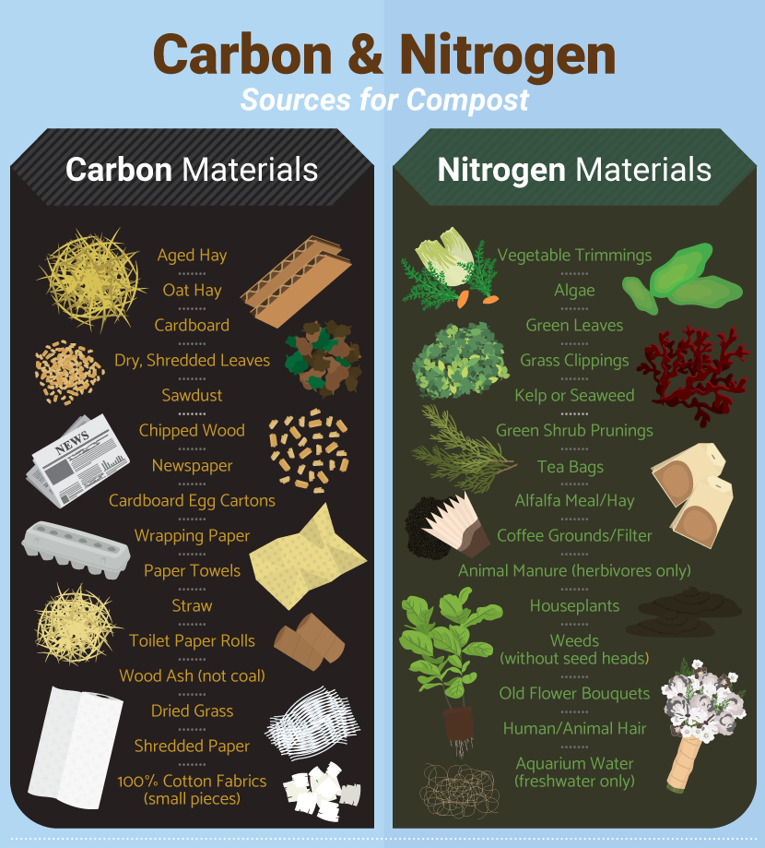

Slide 16
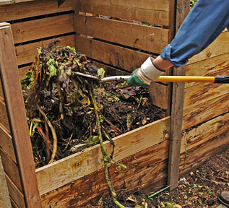
Bin Composting

Slide 17
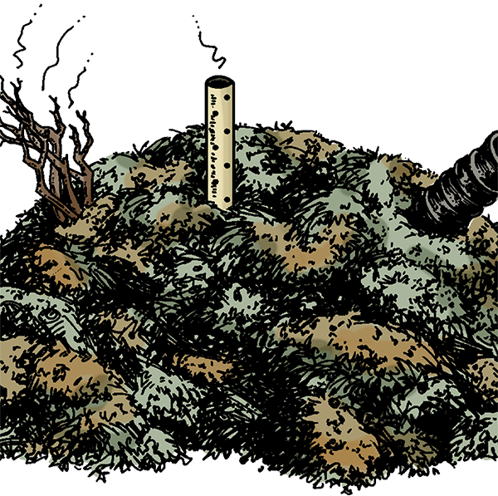
Oxygen
A pile starved for air will become anoxic
or even anerobic
Oxygen acids and amines
(stinky compounds)
Aerobic activity stops
Compost pile is
out-of-balance
Food or water out-of-balance
(low C:N ratio or pile is too wet)
Too many greens
Three types of venting
Notes:
As your decomposers generate heat within your compost pile the warm, oxygen-depleted air will rise to the top of the pile drawing in cool air from the bottom and sides. The fresh air is also high in oxygen. The air around us is 21% oxygen. Our decomposers need oxygen levels greater than 5% in order to survive. If there is no oxygen in the compost pile anaerobic (without oxygen) organisms take over the pile and can produce bad odors.
We need to maintain adequate pore space -- the open area between the materials in the pile -- to allow air to move into and out of the pile. Excess moisture can also fill the pore space and reduce air movement.

Slide 18
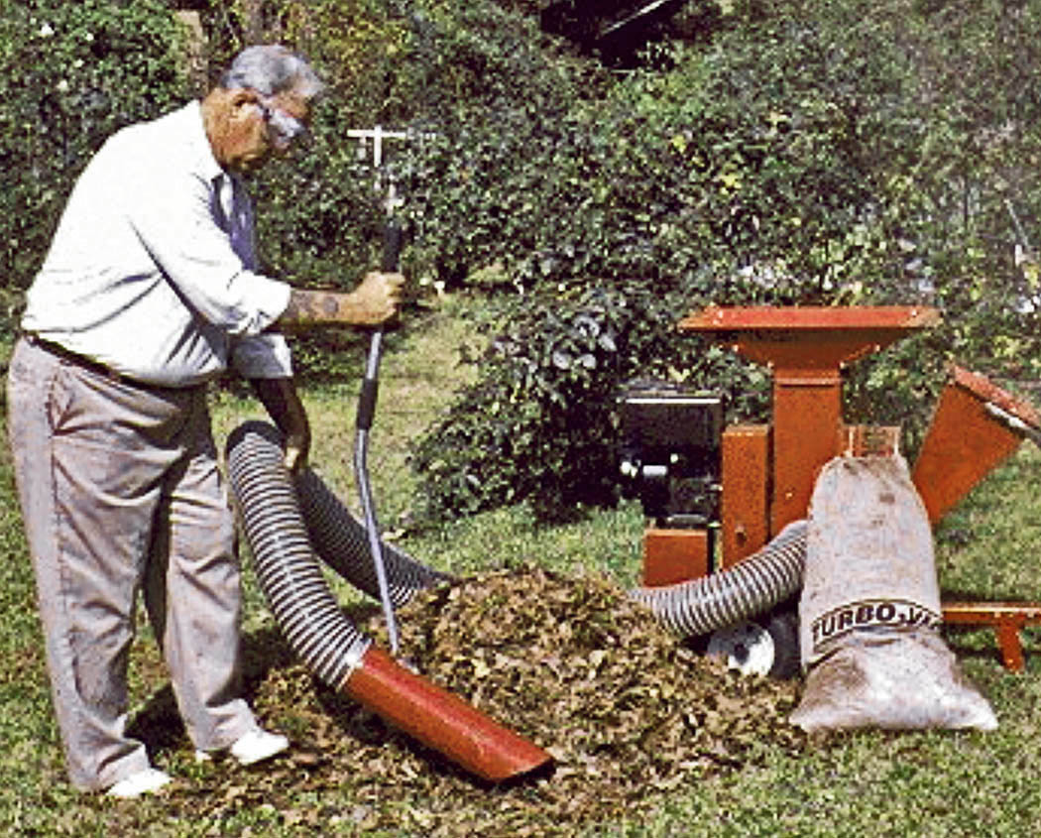
Particle size
Smaller particles have a greater surface area
Some larger particles are needed to
maintain air flow
Particles create
pore space within
the pile
A compacted pile
lacks the needed
pore space
Notes:
Is it necessary to shred leaves, twigs, branches and other coarse materials before putting them in the compost pile? It is not essential, but smaller particles will decompose faster than larger ones because:
As particles are made smaller, more surface area is exposed to the microbes that do the decaying.
Microbes have a hard time getting at the food trapped inside woody materials. If these are broken apart it will speed up the decomposition process.
However, there is a downside to smaller particles. The smaller particles will fit more tightly together reducing airflow in the pile. This causes decomposition to slow and may lead to odor generation. A compost pile with small particles will need to be turned more often to maintain pore space. Ideally a mix of large and small particles will create the needed pore space in a compost pile.

Slide 19
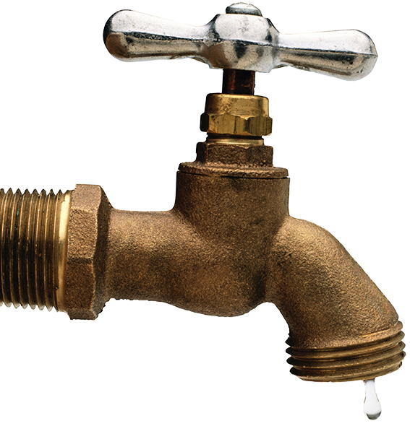
Water
Vital to support compost pile organisms
“Damp as well as wrung-out sponge”
40% to 60% moisture
Notes:
Another essential for rapid composting is the right amount of water. Bacteria live in water films that surround the materials in the compost pile. If the pile is too dry, the bacteria cannot do their work. If the pile is too wet, the bacteria cannot get the oxygen they need.
It can be surprising how much water it takes to get a pile as damp as a wrung out sponge. Even a heavy rain may not be enough to penetrate to the center of the pile.
It is easy to tell if your pile has the right moisture content, grab a handful of material and squeeze. If water drips out, the pile is too wet. If the handful has about the same moisture as a wrung out sponge the moisture is in the right range. If the material feels dry and falls apart it is too dry and you need to add water. Turning the pile as you add water helps to ensure all materials become wet. If your pile is too wet, add some dry browns and turn the pile.

Slide 20
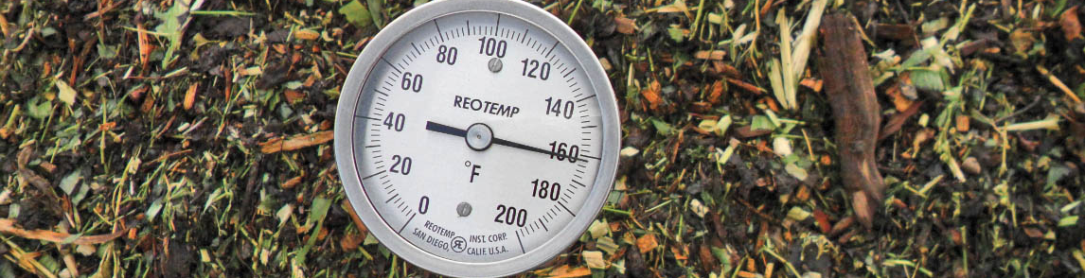
Temperature
90˚– 140˚ is optimal
Temperatures above 130˚ can kill
pathogens and weed seeds
Excessive temps (greater than 160˚)
can kill beneficial organisms
Notes:
Active composting occurs in the temperature range of 55 F to 155 F. Your compost pile will normally go through several heating cycles. To get the most active and rapid composting, the pile should be turned when temperatures begin to drop or if the temperature rises above 140 F.

Slide 21
Does my compost have to get hot?
Good compost can be made in a pile that never gets hot, but
Decay will be slower
Not enough air, too little water or too many browns in the mix could all keep a pile from heating
High pile temperature provides the benefit of
The most rapid composting
Killing pathogenic (disease causing) organisms
Killing weed seeds
Notes:
High temperatures are not essential for composting, but composting will proceed more slowly at lower temperatures. Some of the reasons for a compost pile not heating include:
The pile is not getting enough air.
Too much water in the pile (prevents air from getting in).
Too many browns in the pile mix resulting in a shortage of nitrogen.
Temperatures above 130 F result in a reduction of pathogens -- plant and human -- as well as a reduction in the number of viable weed seeds.

Slide 22
Pile size
Pile should be about 1 cubic yard to maintain temperature
under 1 cubic yard is generally too small to reach temperatures above 130˚F
Larger piles (greater than 3 cubic yards)
May prove difficult to turn
Lack oxygen in pile center
Notes:
The ideal size for a compost pile is about 3 x 3 x 3 feet (1 cubic yard). This size is easy to keep aerated, easy to turn, but still large enough to maintain warm temperatures.
Piles that are too big can be difficult to maintain and often don’t function as well as more appropriately sized piles.
Size is an important factor to consider when selecting the type of bin you will use for composting. Many manufactured bins are smaller than 1 cubic yard and thus have difficulty generating higher temperatures.

Slide 23
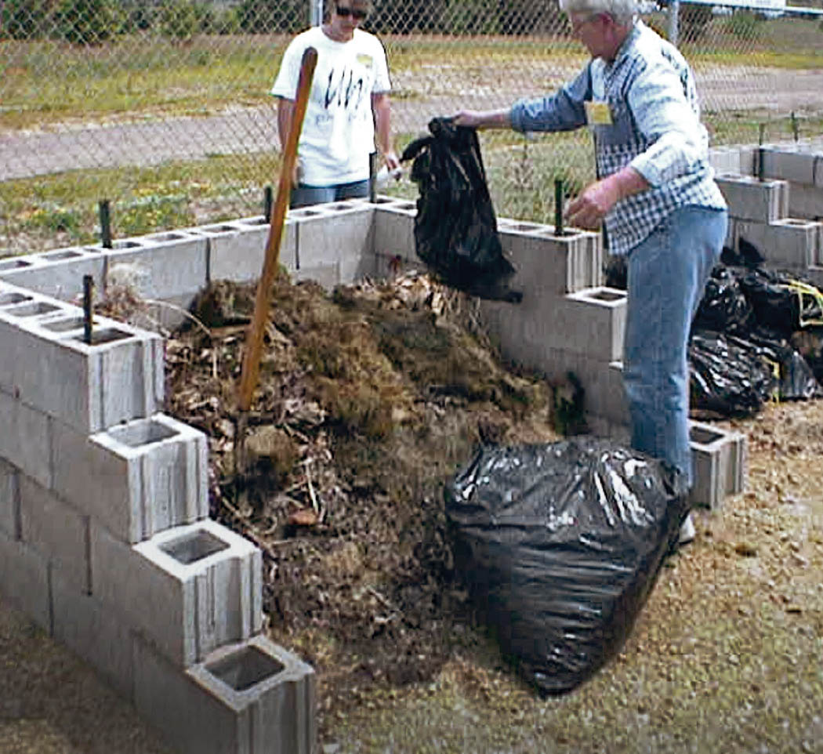
Choosing a compost strategy
Hot piles
Process takes about three months
Plan ahead
Store brown
Cool piles
Process takes
one-half to two years
Add materials as
they accumulate
Less effort
INPUTS = OUTPUTS
Notes:
Choose a composting strategy that works best for you. Your strategy will depend upon the amount of materials you generate for composting as well as the amount of time you are willing to devote to taking care of your compost pile. Your strategy may also depend upon the materials you are composting. For example if you compost kitchen scraps, odds are you generate a small volume of these each week that are added slowly over time to a cool compost pile.
You also may have some piles that are hot piles and others that are cool. You will find out that putting more time into managing will result in compost being created in a shorter amount of time. In the following slides more details about these two strategies will be presented.

Slide 24
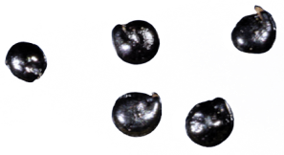
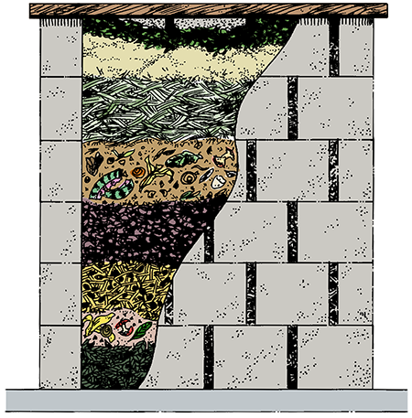
Hot compost pile
Lambsquarter seeds
Pile built all at one time
Pile must be tended
often
Compost in about
12 weeks
Benefits:
Faster than cool method
Reduces weed seeds
1mm
Notes:
This is the most rapid way to produce high-quality compost. The pile is constructed at one time and you will be tending to the pile on a weekly basis initially.

Slide 25
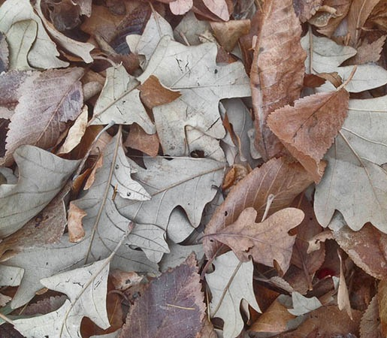
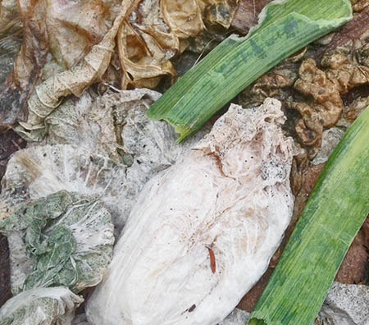
Hot compost pile
Mix 2-3 volumes of BROWNS to 1 of GREENS
Water as you add
materials
Turn pile:
Weekly for first 4-6 weeks
Bi-weekly for next 4-6 weeks
Let cure (let stand without turning)
for 4 weeks after pile begins to cool
Notes:
Remember your job as a composter is to create favorable conditions for the decomposers. Follow the food, water and air guidelines discussed earlier as you build your pile. If you create the proper conditions and your pile is large enough, you will notice a rise in pile temperature in a day or two.
Adding some garden soil or even some finished compost to your pile as you build it can help add some organisms to the mix. Remember to manage pile moisture throughout the process. As your pile heats up, moisture may be lost as well.
You will also notice as the composting process progresses the size of the pile gradually shrinks. This is a sure sign that composting is taking place. The final volume of compost produced can be as little as 1/3 the original size of the pile.
The curing or maturing process is important to ensure the composting process is complete. Immature compost can harm plants or compete with them for nitrogen in the soil.

Slide 26
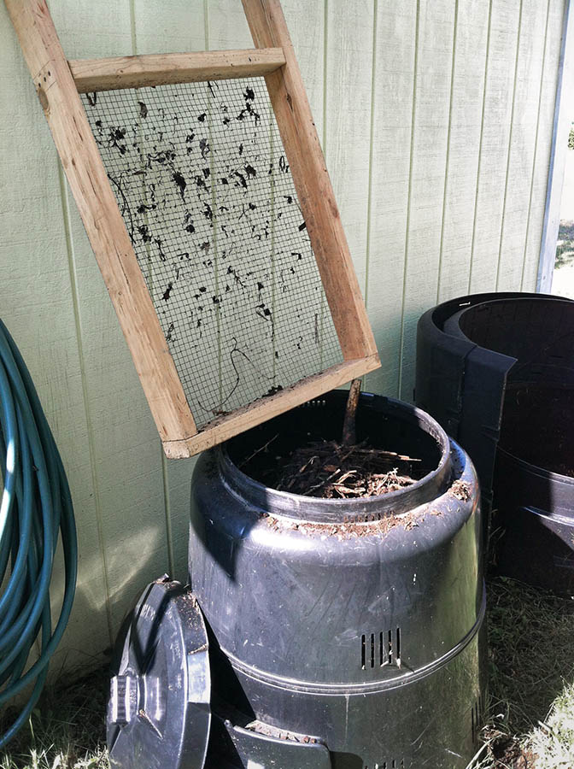
Cool and easy composting
Pile built as materials accumulate
Less intensive
management
6 months to 2 years
Good method for
kitchen scraps
Keep browns handy
to cover
Leaves
Straw
Notes:
The cool and easy composter will add brown and green materials a little at a time. However always try to have the top layer be brown materials to control odors or pests. Take care not to put any weed seeds or diseased plants into a cool pile as it may not get hot enough to kill the seeds or disease organisms.
Save several bags of leaves or have a bale of straw so that during the summer when there is only green in the yard you have browns to add. This can also be the case if you compost kitchen scraps during the winter months. As you add your food scraps to the pile add the proper amounts of brown materials. When warm temperatures return in the spring the composting process will begin.
Water and turn the pile when convenient or when needed. This is especially the case if there are bad odors coming from the pile.

Slide 27
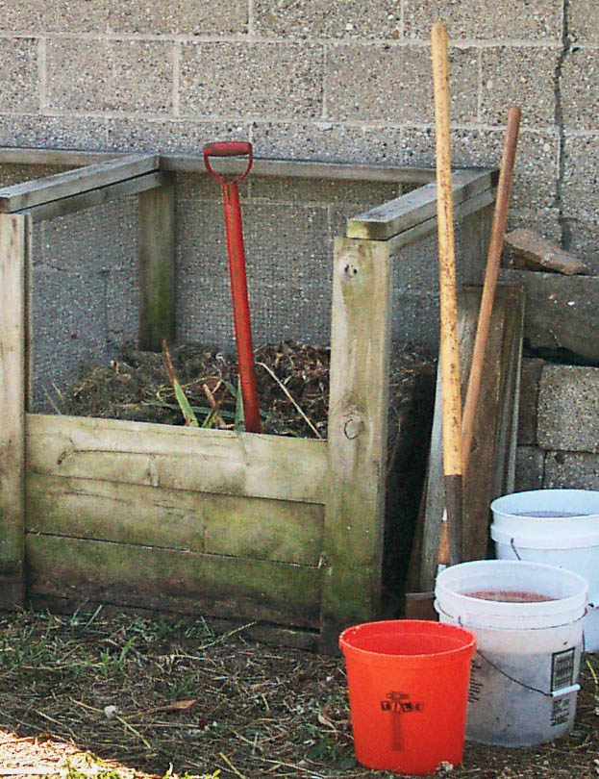
Pile turning tips
Mix materials from outside to middle
Open pore space
Use garden fork
or shovel
Add water if needed
Commercial
turning (mixing)
tools for compost
are available
Notes:
Turning (mixing) the pile helps to bring in fresh, oxygen-rich air into the pile by opening up pore space.
Turning the pile is easier and more effective if you take your bin apart and set it next to the compost pile. Then transfer materials into the empty bin by placing the outer materials into the center of the new pile. Having two bins, one that is empty, also works for this transfer.
Turning tools may help mix the pile to some degree, but most people find that a sturdy garden fork works best.

Slide 28
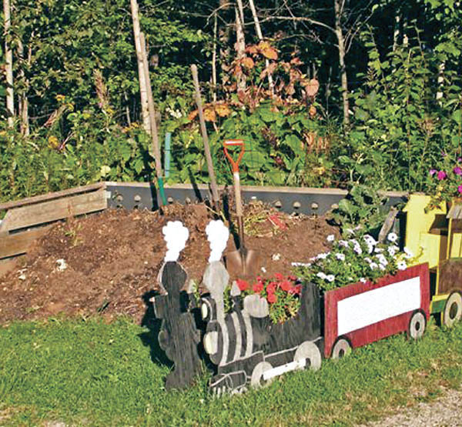
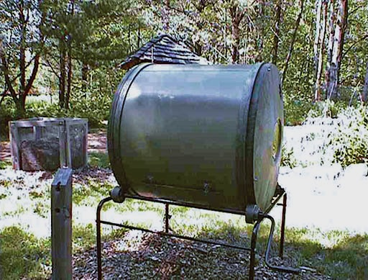
To bin or not to bin
Composting does not require a bin, but be sure to select a method that will work for you
Compost heap, pile, trench and sheet may have
aesthetic concerns
Bins can be home-built
or manufactured
Notes:
There are many different options for compost bins. If you get serious about composting, you may find one bin just isn’t enough. Bins generally work better than heaps or piles. In some communities covered bins are required for compost piles.

Slide 29
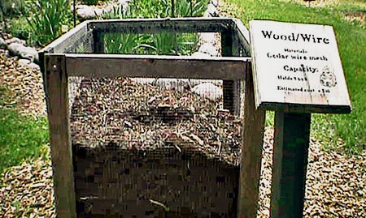
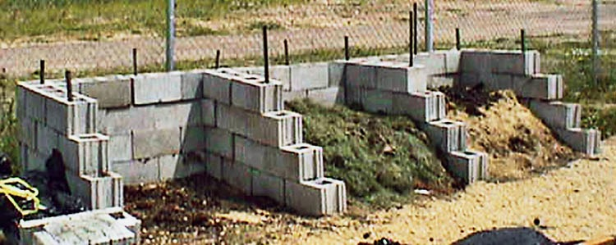
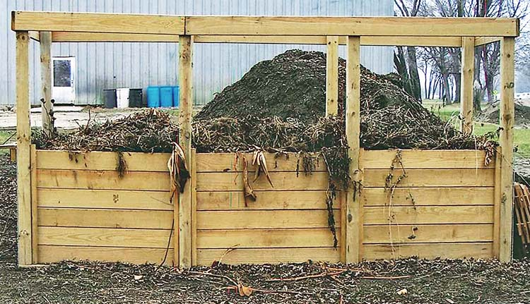
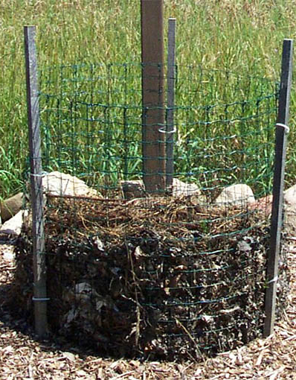
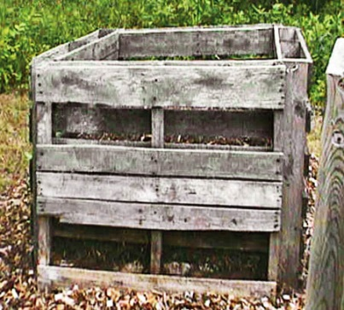
Examples of home-built bins
Wood/Wire
Concrete Block Three-Bay
Wood Pallets
All-Wood
Wire Mesh
Notes:
Here are some examples of home-built compost bins. Some are made from purchased materials while others, such as the pallet bin can be made from materials others no longer want. UW-Extension has a number of compost bin plans that you can use to build your own.

Slide 30
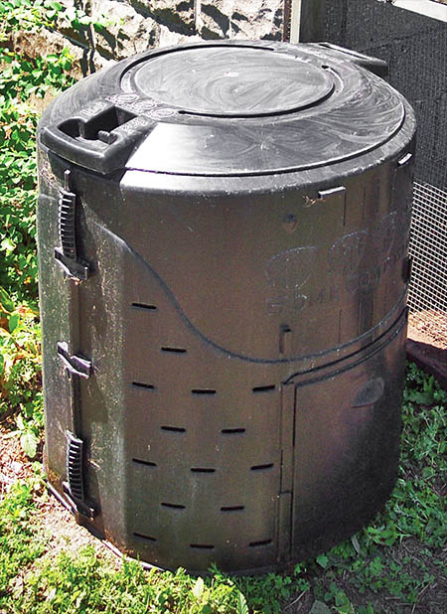
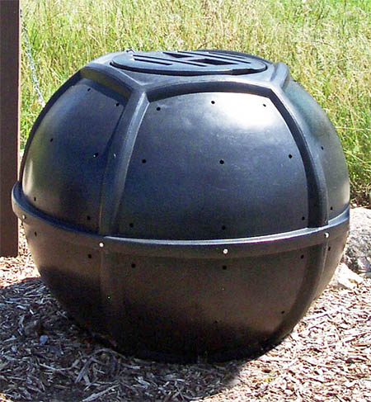
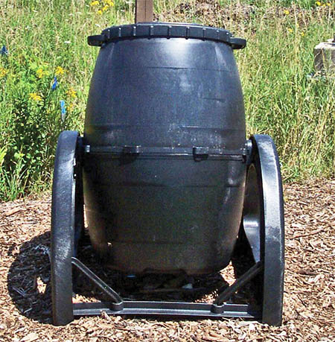
Examples of commercial bins
Home Composter
Orb
Tumbler
Notes:
There are many manufactured bins available to composters. Cost can range from $30 to $40 to hundreds of dollars. Most bins are easy to set up and use, and some include mechanisms to assist with turning. Some factors to consider when shopping for a compost bin is size (larger is better), cost and durability.

Slide 31
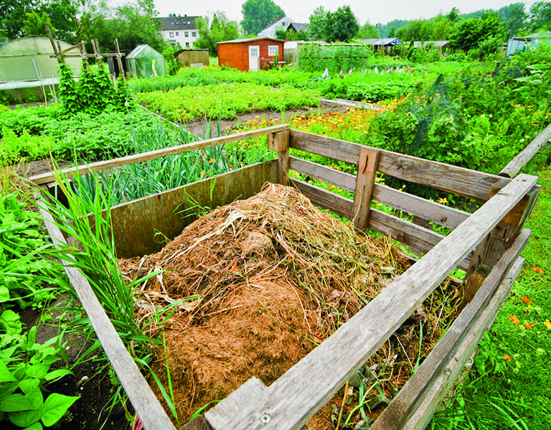
Bin or pile location
Near where the compost will be used
Two feet or more from buildings
Good drainage
Away from wells
Be a good
neighbor
Check local
ordinances
Notes:
Use common sense when selecting a location for your compost pile.
A shaded area helps keep the pile from drying out in the summer and makes it more pleasant for you to work at the pile. However a sunny location will warm up sooner in the spring and freeze later in the fall.
Be sure the location won’t interfere with your other lawn and garden activities and fits into the landscape. Place it in a location that is easy to access.
Leave adequate workspace around the pile for filling, turning and emptying.
Consider having space for stockpiling browns in the fall and for storing finished compost until you are ready to use it.
Keep within reach or a garden hose so you don’t have to carry pails of water to the pile.
Be considerate of your neighbors. Keep your pile neat and tidy as well as well-aerated.

Slide 32
Tools

Slide 33
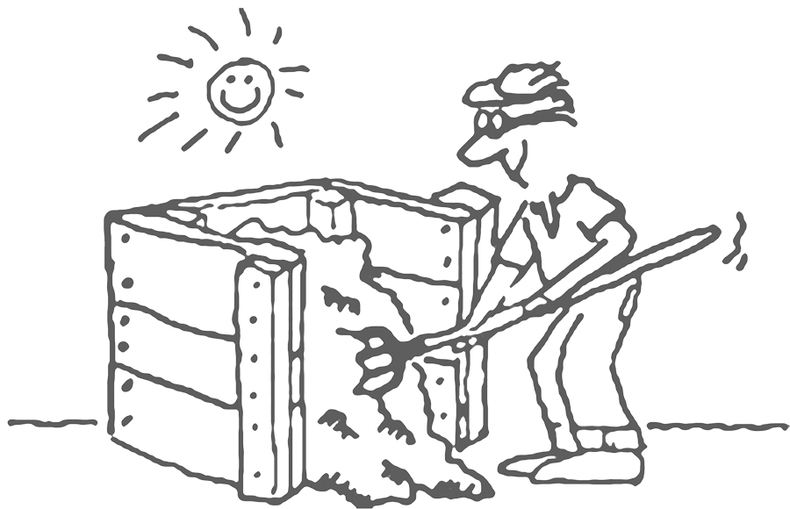
Troubleshooting
Nothing is happening!
Pile is too dry
Not enough “greens”
My pile stinks!
Too wet
Excess “greens”
Pile compacted
Pests
Notes:
Sometimes composting doesn’t go just as you would like. If problems arise, here are some possible solutions:
Decomposers need moisture and a balanced diet to make compost. If nothing is happening and the pile is dry, add water until the material feels like a well-wrung-out sponge. Another common problem is having too many browns in the pile. A compost bin full of leaves will decompose very slowly, but if we add in some green material we will speed up the composting process.
At the root of foul odors is poor aeration and lack of carbon (brown) materials. The cure is to turn the pile and add dry browns. If you are adding kitchen scraps, be sure to mix them into the pile. A small pile of kitchen scraps could start to smell and attract unwanted critters.
Ammonia odors usually mean you have too many greens in the mix, so excess nitrogen is being converted to ammonia. Add browns to balance the diet. If you have rotten-egg smells, your pile may be too wet or not porous enough. Add brown and turn the pile.

Slide 34
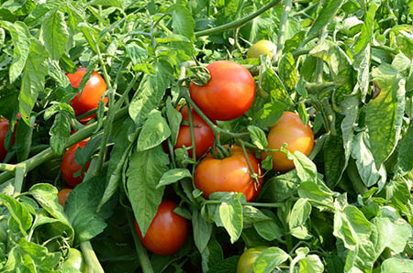
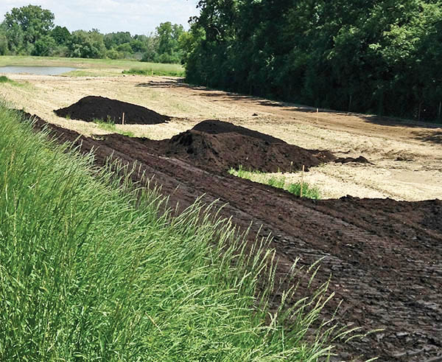
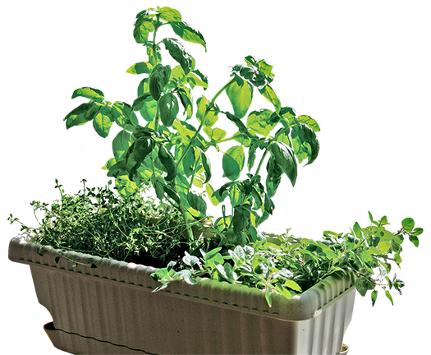
Using compost
Gardens, flower beds, lawns
and houseplants
Clay soils – improves
drainage and tilth
Sandy soils – increases
moisture holding
All soils – improves
soil structure
All soils – adds nutrients:
nitrogen, phosphorus,
potassium and
micronutrients
Notes:
Compost is referred to as a fertilizer by some, but it can do much more for your garden than just deliver nutrients such as nitrogen, phosphorus and potassium. Compost provides many benefits to the soil. It can loosen heavy clay soils or it can help sandy soils hold onto moisture. In all soil types it improves soil structure and adds organic matter which stimulates beneficial soil organisms. Compost has also been shown to reduce soil-borne plant diseases. Adding compost improves soil health, yields healthier plants and reduces the need for pesticides.

Slide 35
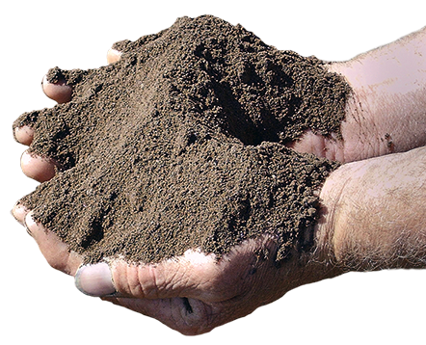
When the composting process
should be finished
Finished is also known as “mature”
or “stable” compost
Compost is dark, loose
and crumbly
Organic materials are
unrecognizable
Ambient temperature
Notes:
Before you use your compost be sure it has matured. The compost should have an earthy smell and you should not be able to recognize any of the ingredients you used to make the compost.

Slide 36
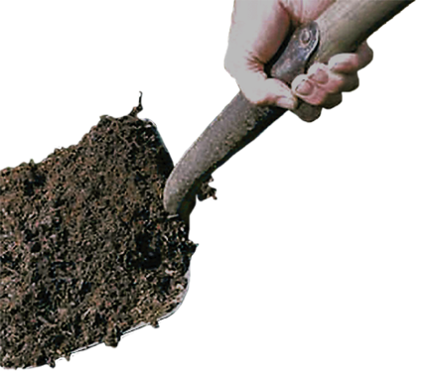
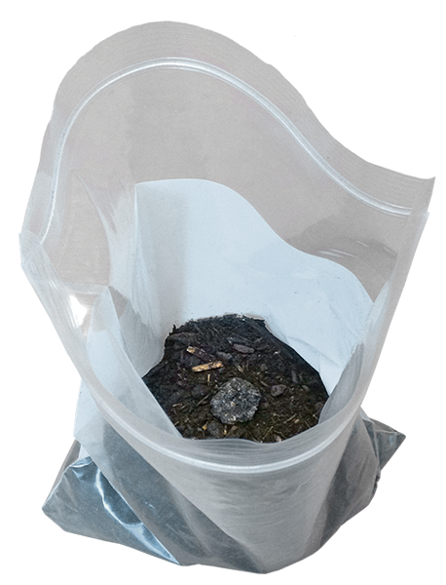
Simple test for
mature compost
Germination test
Will seed germinate in compost?
Good test if using
for potting soil
Bag test
Seal compost in a
plastic bag for 5-7 days
Should produce
no foul odor
Notes:
You can perform a couple of simple tests on your compost to see if it is mature. Cucumbers seeds can be used to check your compost. Fill two or three 16-ounce plastic cups three-fourths full of compost and plant five cucumber seeds in each cup. In the same number of cups place a soil mix you know to be good and add the same number of seeds, this is your control. Water and place the cups in a warm sunny spot for 14 days. Make sure the cups don’t get too dry. At the end of the trial period compare the plants in the compost with those in the control. If the results are comparable the compost is ready to use. If the seeds in the compost don’t germinate or the plants appear stunted, allow the compost to mature longer before using.

Slide 37
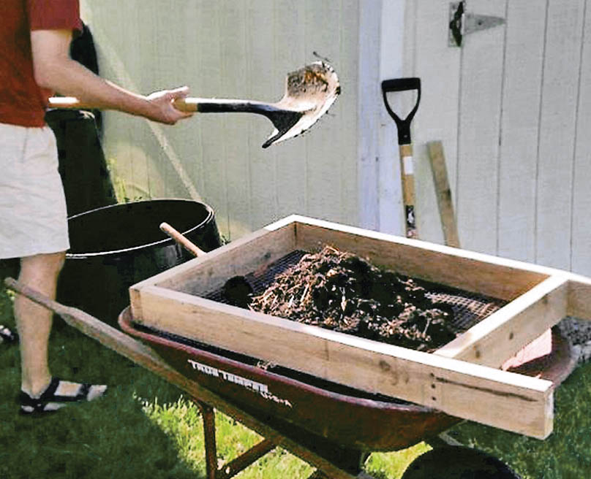
Compost use continued
Unfinished compost can pull nutrients from the soil where it is placed
Compost can
be screened
Removes larger
particles
Necessary if used
for top dressing
Notes:
You can build your own screen using hardware cloth with half-inch openings. The larger particles you remove can be added to your next batch of compost.

Slide 38
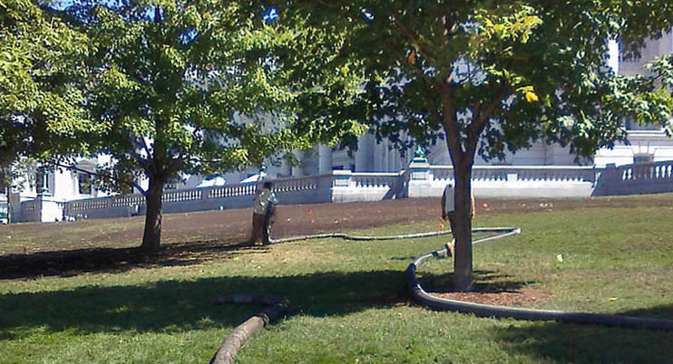
Compost application rates
2 inches mixed into top 6 to 8 inches of soil
Side-dress or mulch:
1-3 inches
Top-dress lawns:
up to ½ inch
screen compost
Spreading compost on the Wisconsin State Capitol lawn
Notes:
Compost can be used in a number of ways wherever you are growing plants.

Slide 39
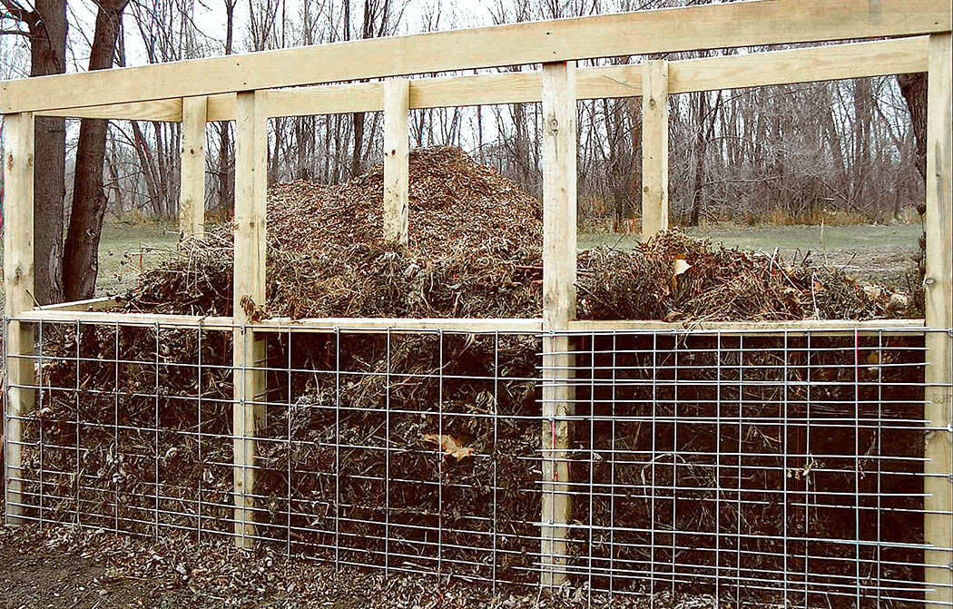
Composting key points
Balanced
diet
Keep pile
damp
Turn pile
when you
need to

Slide 40
Types of Composting
Bin
Lasagna composting
Trench

Slide 41
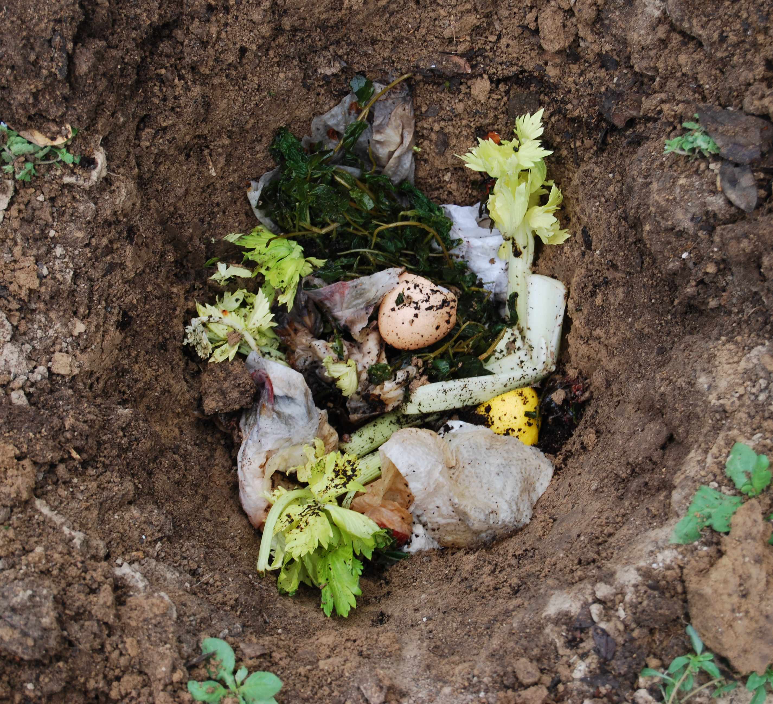
Trench Composting

Slide 42
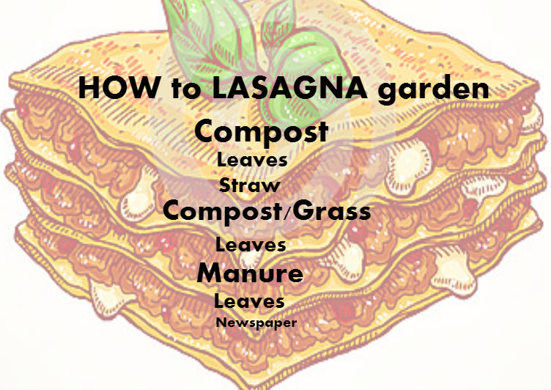

Slide 43
Group Discussion/Questions

