Slide 1


Many Media
Communication Strategies for reaching all your gardeners

Slide 2
Many Media: Goals
Review Communication Options
More Options
More Gardeners
Less Work?

Slide 3
Many Media: Types
Email
Phone calls
Texting
Social Media
Mail
In person

Slide 4
Email
Most common
Strategies to make easier
Avoid coordinator bottleneck
Tech-savvy bias – who does it leave out?

Slide 5
In Person
More rare, more work
Personal connection
Immediate dialogue
Accountability
Use captive audiences
How can these benefits be captured by other methods?

Slide 6
Phones – calls and texting
Still personal
Time investment and burnout potential
Set boundaries
Automation

Slide 7
Mail
Reaching a different audience
Money investment
Physical nature results in longer term impact
Also a good strategy for breaching language barrier
Set boundaries
Automation

Slide 8
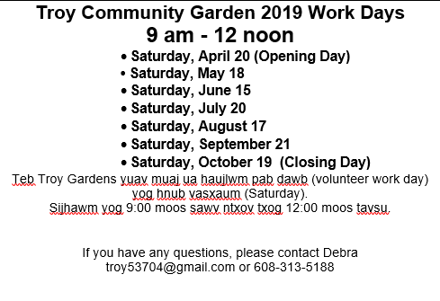
Mail

Slide 9
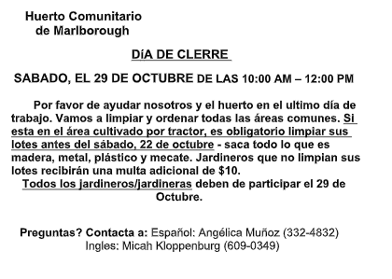
Mail

Slide 10
Social Media
Fractured
?

Slide 11
General Suggestions
Think about who you want to communicate with and why, how that affects the medium you chose
Preparation ahead of time
Goal of reduced work, more distributed work

Slide 12
Questions and Comments

