Slide 1

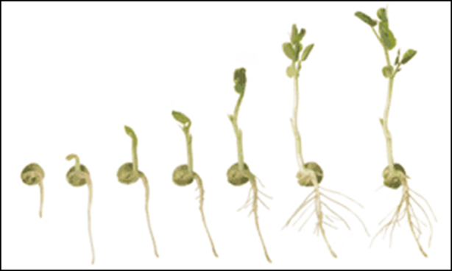

Seed Starting
Lisa Johnson
Dane County UWEX Horticulture Educator
608-224-3715
Johnson.lisa@countyofdane.com
Mike Maddox, MGV State Program Office
Sharon Morrisey, Milwaukee County UWEX
Notes:
Hello, my name is _______________________ and I am a graduate of the Dane County UW-Extension Master Gardener Volunteer program which trains community volunteers in a broad range of horticultural subjects so they can bring this knowledge to the public. The Dane County Extension office is here to serve you and has expertise in many areas including agriculture, horticulture, family living topics such as financial education and preserving and canning garden produce, youth education through the 4-H program, strategic planning services for municipalities and organizations, nutrition programs through the WI Nutrition Education Program and environmental education programming. Thank you for inviting me to speak to you today about seed starting.

Slide 2
Dane County UW extension
Master Gardener Volunteer training
  http://dane.uwex.edu/horticulture/master-gardener/
UW Extension
  http://hort.uwex.edu/
  http://learningstore.uwex.edu/
UW Plant Disease Diagnostic Clinic
  http://labs.russell.wisc.edu/pddc/fact-sheet-listing-all/
http://www.missouribotanicalgarden.org/

Slide 3
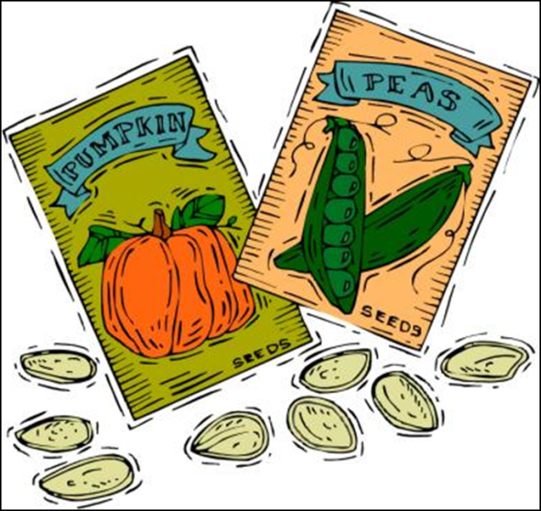
Starting Plants From Seed
Purchasing Seeds
Storing Seeds & Viability
Timing of Seeding
Containers
Media and Sowing
Germination
Temperatures
Lighting
Watering, Fertilizing
Thinning
Transplanting
Hardening off
Notes:
Starting plants from seed can be a rewarding activity—or sometimes a frustrating one. Today we are going to cover these subjects that relate to growing seeds so that you will have a good foundation in growing seeds. You should know though, that even experienced seed starters don’t always have one-hundred percent success, so don’t be discouraged if your efforts are not completely successful the first time.
How many of you have done seed starting before? (Allow some audience sharing of experiences and see if some may be willing to mentor others. Tell audience that the info presented today should help them be more successful and answer some questions—also refer them to the Dane County UWEX Horticulture Helpline at 608-224-4715—that will be given later in the presentation as well, as well as some online and printed resources).

Slide 4
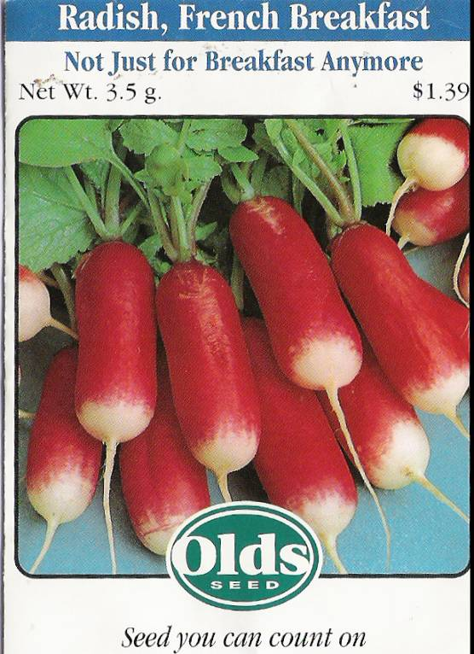
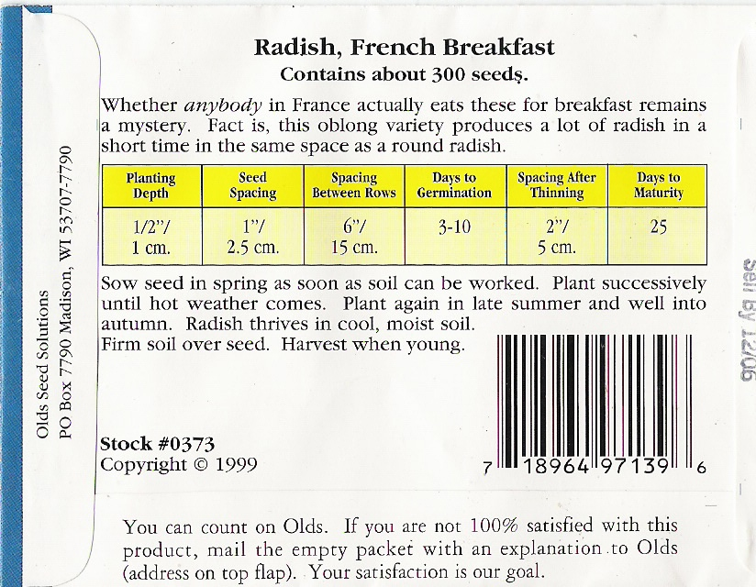
Starting Plants From Seed
Check the seed packet for information –
Freshness Date
Germination Time
Planting Suggestions
Notes:
If you are purchasing seed, it should be fresh and labeled for the coming season. This information is typically on the packet. Seed packets contain a wealth of critical information. Be careful when you open the packet so that you don’t accidentally rip off and discard important information like planting depth, seed spacing , how long the seed should take to germinate and days to maturity. Some seeds also need special conditions for maximum germination, and that information should be on the packet as well. We’ll talk more about that later.

Slide 5
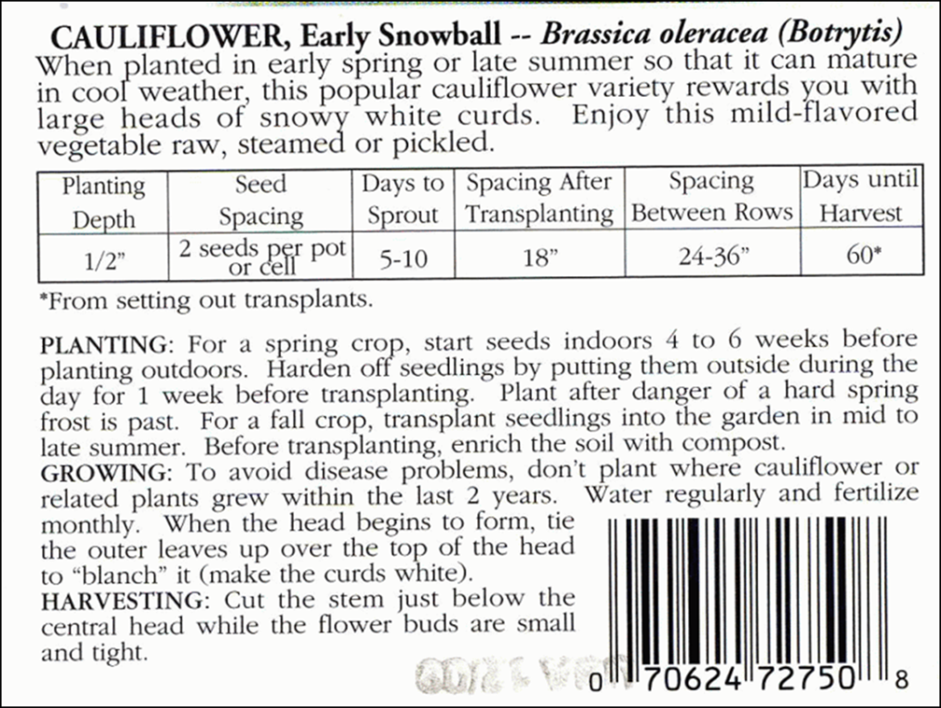
Seed Packet Info, continued
Use disease resistant cultivars when available—especially for tomatoes and cucumbers
Notes:
One thing that can be really helpful is buying disease-resistant varieties of plants, especially for tomatoes, cole crops like broccoli, cauliflower and cabbage, and cucurbits like squash and cucumbers. If you look on the seed packet, it will often have capital letters that indicate their resistance to various soil-borne diseases.

Slide 6
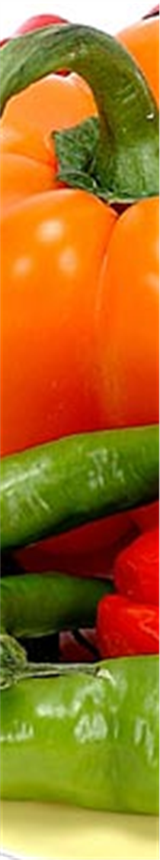
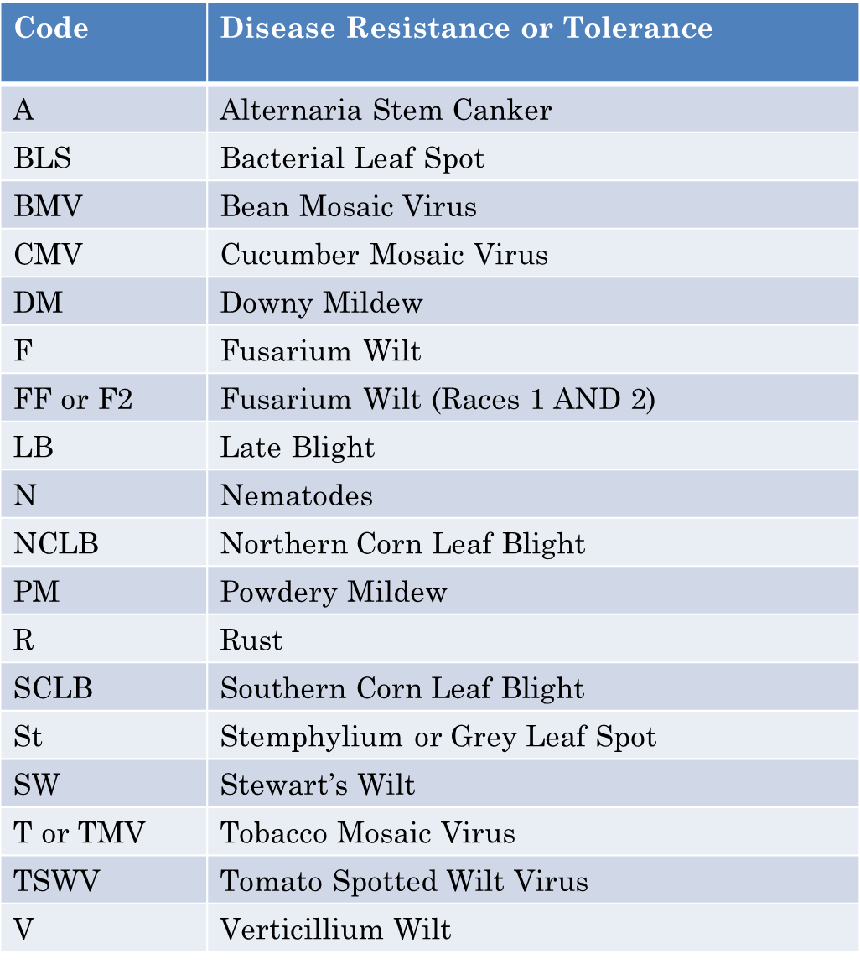
Disease Resistance Codes
http://www.a-harvest-to-remember-vegetable-gardening.com/disease-resistant-plants.html
Notes:
These are some of the more common disease resistance codes you may find on seed packets. For tomatoes, look for F for fusarium wilt and V for verticllium wilt, two soil-borne diseases that can devastate tomatoes. There are also some tomatoe varieties that are resistant to late blight; you can get that list from Lisa Johnson at the Extension office. One thing to keep in mind is that resistance does not mean immunity; under the right conditions, even a resistant plant can become infected with a plant disease.

Slide 7


Seed Starting
Fresh seed germinates best
Store seeds in a cool, dry place. Best kept in tightly closed containers at ± 40° F at low humidity.
Germination rate decreases with the age of the seed. Some seeds are viable longer than others
Onions: 1 year
Corn and peppers: 2 years
Beans, carrots, peas: 3 years
Beets, pumpkins, squash, tomatoes, watermelons: 4 years
Broccoli, cabbage, cucumbers, lettuce, cantaloupes, radishes, spinach: 5 years
Notes:
Since fresh seed germinates best , it is a good idea not too buy too much more than you need. This is a temptation that can be hard to resist! If you do need to store seeds, they need to be kept cool and dry. They are best stored in a container with a good seal, like an old film canister or ziplock bag and they should be stored in dark conditions. The older the seed is, the more its viability decreases. The list on this slide gives you an idea of how long seeds of various plants retain their viability under ideal storage conditions. So you may want to look through any seeds you have at home and throw out any that are older than 5 years, since they are not likely to have a good germination rate.

Slide 8
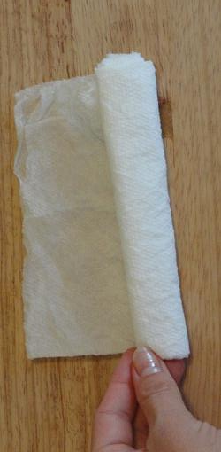
Seed Starting
  Germination rates for fresh seed: 80-100% will germinate, 60-75% will grow into useful seedlings
Seed Roll Test: take 10 seeds, put in a moist paper towel in a plastic bag (not sealed). Keep at 70ºF or so for the amount of time the package says is normal for germination. If rate is 60-80%, plant, but maybe a bit more thickly than usual
Dannylipford.com
Notes:
If you are not sure whether your seeds are still viable, you may want to make a seed roll to test a few of the seeds. It’s a really simple process. Roll 10 seeds in a moist paper towel or napkin and put in an unsealed plastic bag –it may mold under sealed conditions, so keep it slightly open. Check it for germination after the amount of time indicated on the package. You can extrapolate the numbers into a percentage. If 4 seeds germinated; figure that only forty percent of your seeds are viable. That might not be enough for you to bother with and you may want to get a fresh packet of seeds. Six seeds or more is usually good.

Slide 9
Timing of Seeding
Average growing season in metro Madison
  May 15st – Oct. 21st = 164 days
    Avg. Frost Free Date to Avg. First Frost
    Average frost-free date still means a 50% chance of frost!
Count back from days to harvest (on packet)
  Include germination time
  Often there is guidance on when to start inside (ex. 6 weeks before average last frost)
  In Madison, most seeds can be started inside in mid- to late-March.
  Wait longer to start cucurbits
Notes:
Next, you need to figure out when to start your seeds. Many plants like tomatoes and peppers need a long growing season to bear fruit; much longer than we normally have here. So we generally start those plants from seed indoors or buy transplants from our local garden centers. In Madison, we usually can start planting a few cold-tolerant crops outside by the middle of April and usually tomato transplants can go out by the 15th of May, but this is not always the case! Often it is still too cold on that date in May. If it is still freezing at night on a regular basis, or under 45°F, it’s best to wait. Remember that even though May 15 is our average frost free date; it means that there is still a 50% chance of frost! Figuring out when to start the seeds so they will not be too big and spindly before going outside is something of an art, but a good guideline to use is that most seeds can be started in mid-late March. Bigger tomatoes should be started a bit later as they just get too big before they can go out. Wait until April to start cucurbits like cucumbers or melons if starting them inside.

Slide 10

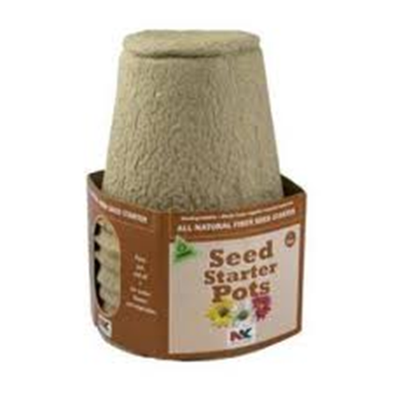
Timing of Seeding
Squash, cucumbers and melons don’t transplant well, so if starting indoors, start in peat or coir or paper pots that can be put directly into the ground and will biodegrade
Notes:
Speaking of cucurbits, they all have brittle root systems that don’t like to be disturbed, so if you are going to start them indoors, use peat or paper pots that will biodegrade so you don’t disturb the roots by taking them out of the pot when planting. Cucurbits, although we recommend planting them outside in early June will usually grow faster once the soil is warm outside and will usually ‘catch up’, but some people like to start them indoors. They will not germinate in cold wet soils, so don’t put seed out too early. Some people mound up their soil and use black plastic with holes cut out for the plants to warm the soil and keep the leaves and fruits from contacting the soil. Commercial growers often use this method to boost production. Growing the plants in raised beds can also get you the warmer soil earlier in the season.

Slide 11
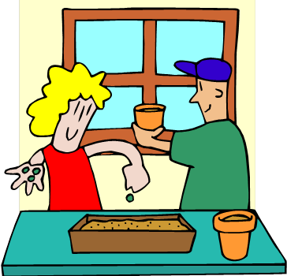
Why Start Seeds Indoors?
Why Indoors?
  Small seeds
  Seeds that need warm temperatures to germinate
  Long season plants
Supplies needed
  Clean containers (with drainage)
  Bright natural light or grow-lights
  Sterile seed starting medium
  Location with proper ventilation and temperature
  Bottom heat--maybe
Notes:
There are a lot of good reasons to start seeds inside besides providing a longer growing season for crops that need it. For example, small seeds can end up sifting down through cracks in the soil outside too deep to germinate and that can be controlled indoors. You have a lot more control over growing conditions and can provide optimal conditions for seeds that need warm soils to germinate and warm air temperatures to grow in at a time when those conditions are not present outside. You need a few supplies to get started, but once you have those you can re-use some of them like lighting every year, so it doesn’t need to be a large investment.

Slide 12
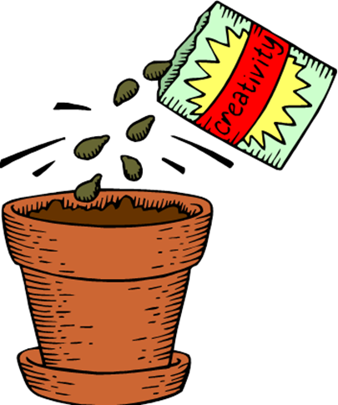
Containers
Containers
  Any container with drainage will do (except ones with copper insides or ones that diseased material grew in
  Disinfected
    Clean off any soil with a brush. Soak several minutes in 10:1 bleach solution
  Good drainage
  Adequate root space but not excessive
Notes:
Some people like to grow their seeds in flats and transplant them into pots, some people use pots to begin with. Many people use re-purposed containers that we’ll talk about next. The main thing you need for a successful container is that it is clean and has drainage holes. Don’t use anything with copper linings—that inhibits root formation. Also don’t re-use containers that had diseased plant material growing in them, as the pathogens can remain even after cleaning.

Slide 13

Containers
Containers
  Flats
    Broadcast or sow rows 2” apart
    Transplant to packs or pots later
  Plastic cell packs
  Peat or coir pots
  Cardboard egg cartons (these may decay before the seedling can go outside)
  Deli, yogurt and fast food containers with holes cut into the bottom
Notes:
If you want to use flats, you’ll need a set of two—one with holes for drainage that you plant in, the other without holes that you set the first flat into so that you don’t get water draining all over your floors. You should set the first tray on shims or pebbles in the second tray to create some airspace. Typically with flats there is more thinning that needs to be done and transplanting later. If you are not going to be growing the seedlings in containers for very long (about a month to 6 weeks) you may want to seed directly into market packs and from there transplant outdoors. The root space is more restricted, so keep that in mind when seeding larger crops. As you can see there are a fair number of options for re-purposed containers, you just need to be sure to provide drainage holes.

Slide 14

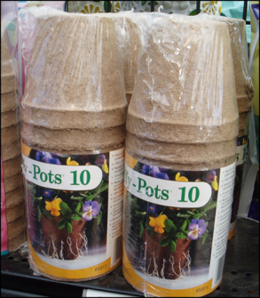
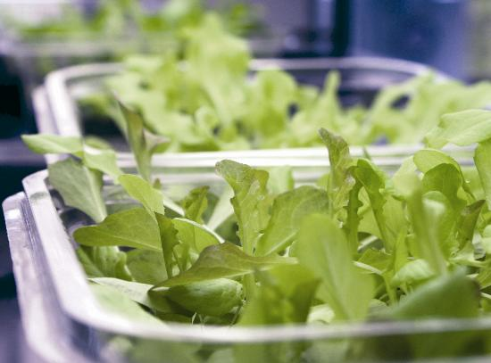
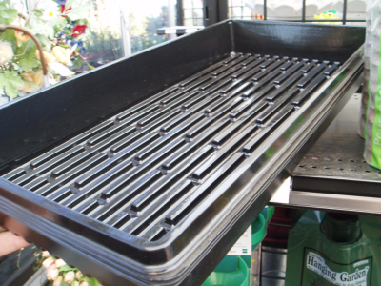
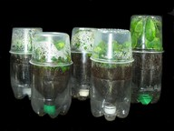
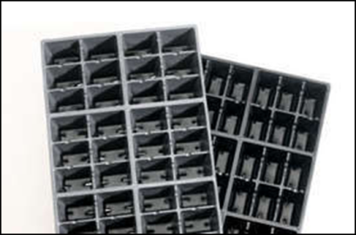
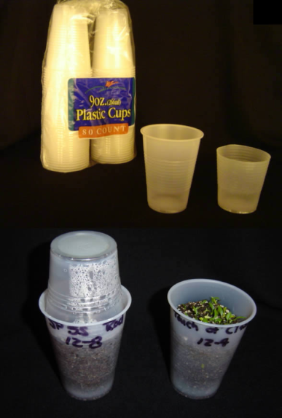
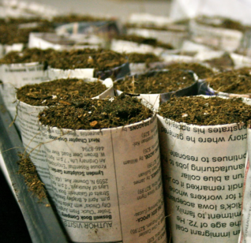
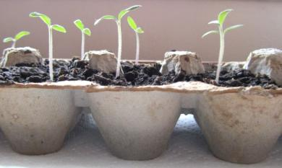
Containers
Notes:
These are some photos of standard and re-purposed containers. Again, there are a lot of options out there.

Slide 15
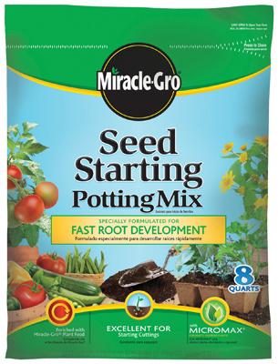
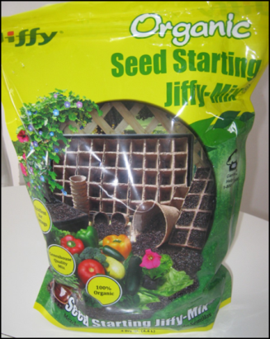
Seed Starting Media
Use seed-starting mix to plant seeds indoors as opposed to potting soil
Usually soilless mixes with ground sphagnum, vermiculite. Are porous, fine-textured, hold water, aerated, not high in nutrients, pasteurized, balanced pH
Make sure the medium is moist! Mix in water with clean tools
Use a sprinkling head on the watering can with small holes so seeds aren’t washed away
Notes:
Especially when you have small seeds it is important to use a seed-starting medium rather than houseplant potting soil which is much more coarse in textured. Seed-starting mixes are typically very fine-textured and designed to hold moisture while still being well aerated. They are very fluffy so that there is little resistance for young roots to push through.

Slide 16
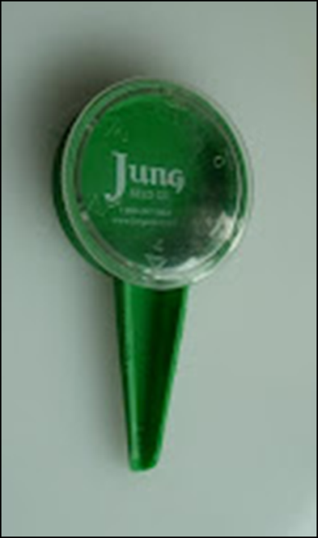
Seed Starting
Moisten media so it almost drips when squeezed
Fill pot or cell-pack to top with moistened medium
Gently press down and add more medium if needed, leave a small water reservoir
Can use fine sand or sugar to help evenly distribute tiny seeds
Can use Dial-A-Seed planter, or a moistened popsicle stick or pencil eraser to help plant seeds
After planting, water in gently
Notes:
One problem with the seed starting mixes is that the material is often dry when purchased and it really needs to be thoroughly wetted BEFORE the seeds are sown. We recommend that the mix be wet enough to just start to drip when it is lightly squeezed. Even though the material is now wet, it should still be firmed down very gently before you sow the seeds. Then water gently after seeding using a watering can with small holes in the rose or sprinkling head. If you are planting very small seeds you may want to use fine sand to help separate and distribute them more evenly. You can use the seeding device shown above (they have them locally at Jungs and they may also be at other local garden centers). You can also moisten a popsicle stick or other tool to pick up and move small seeds.

Slide 17
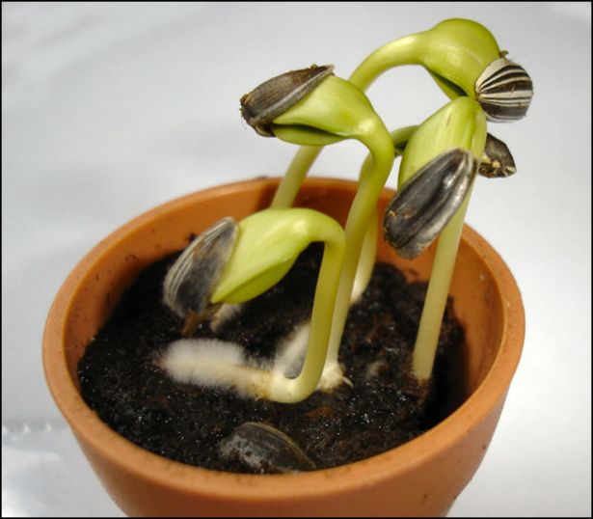
Germination
Factors affecting germination
  Seed age
  Moisture
  Temperature
  Light (or dark)
  Oxygen
  Genetics
Notes:
Ok, now let’s talk about factors that affect seed germination. We’ve already talked about the direct effect of seed age on germination rates. Another factor is moisture. The seed coat has to be softened and water needs to enter the seed to begin the germination process. Once that process begins, if the seed dries out again, it will often fail to grow. So moisture needs to be consistent once the process begins. Seeds of different species need different soil temperatures for germination. Some plants like peppers germinate better with higher soil temperatures and may not germinate well in a basement or minimally heated room, for example. Some seeds such as lettuce need light to germinate, so they should not be planted too deeply. Other seeds may need dark conditions to germinate. Oxygen is necessary for germination as well. Seeds will not live in anaerobic conditions, so be sure not to overwater. Also some seeds have more internal barriers to dormancy due to their individual genetics. We’ll go over these points in a little more detail now.

Slide 18
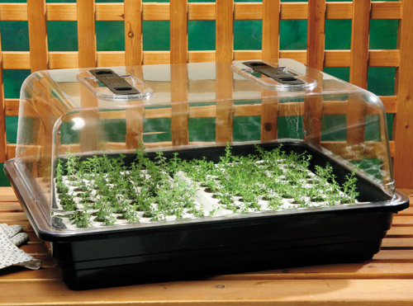
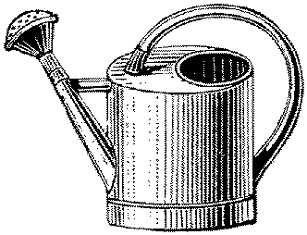
Watering Seedlings
Can water from below in tray before seeds germinate and when seedlings are very small, but don’t allow packs or pots to sit in water
Allow slight drying between waterings
  Helps prevent disease
Don’t let seedlings wilt
Plants shouldn’t stay wet, though humidity is important
Notes:
So to reiterate, while moisture is important, seedlings shouldn’t sit in water because that limits oxygen—not a good thing. Humidity is important, and some people use misters, while others use a plastic dome or ziplock bags. While the domes are re-usable, they are somewhat expensive. It’s important that the covering , whatever it is, doesn’t sit on the plants and condensation is not allowed to build up on the seedlings, which can encourage disease.

Slide 19
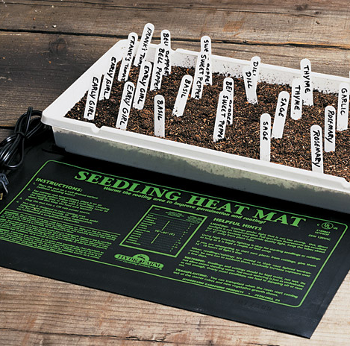
Soil Temperatures
SOIL Temperature: Many seeds have minimum, maximum, and optimum soil temperatures at which they germinate.
Generally, 70º to 75ºF works for most plants.
http://cmg.colostate.edu/gardennotes/720.pdf
A heat mat may be helpful. Don’t use heating pads meant for people!
Notes:
Soil temperature is a very important factor. Many of us grow different seeds in the same flat, meaning the soil temperatures are similar, so it helps to know which crops work best together in this regard. The link to the Colorado State Master Gardener recommendations gives many crops’ optimal soil germination temperatures. For example ‘cool season’ plants (such as lettuce, beets, spinach, cole crops, onions, potatoes and peas) and will take cooler soil and air temperatures while ‘warm season’ crops such as peppers, tomatoes, eggplant, melons, cucumbers and squash need warmer soil and air temperatures. Heat mats may be helpful if you have your growing area in a basement. A 2-flat size mat is approximately $40. Be sure that you don’t use a heating mat meant for people as electrocution and fire hazards can result.

Slide 20
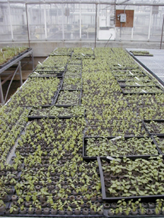
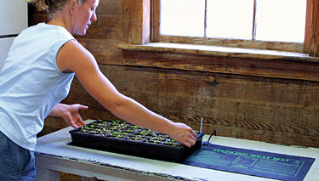
Air Temperatures
AIR temperatures:
Day temperatures about 65-75°F
Night temperatures 60-68 °F (about 10°F lower)
Cool season crops need cooler day and night temperatures, about 65°F for day and 55°F at night
Notes:
You might not think about air temperatures as being important, but seedlings can be stunted by cold air temperatures in minimally heated rooms or locations next to drafty windows. In general, night temperatures should be about 10°F lower than daytime temperatures for best growth. Again, cooler season crops can be grown at lower air temperatures than warm season crops.

Slide 21
Lighting for Seedlings
Seedlings need bright light. If you use a window for growing, rotate the plants to prevent a phototropic response.
It may be best to use artificial light. Use a 40-watt cool-white and a warm-white fluorescent tube OR plant growth lights. Do not use incandescent bulbs!
Position seedling 1-3” from the tubes and keep the lights on about 16 hours each day. Timers are helpful. Spinach and lettuce may bolt with more. Move either the lights or flats as the seedlings grow so they don’t grow into the lights.
Notes:
Seedlings really need a lot of light to prevent them from getting tall and spindly. If you are using solely natural light, you should have a west or south-facing window to give at least 8 hours of light, preferably more. Rotate the flats regularly so the seedlings don’t start to ‘lean’. If you are using artificial lights, 16 hours a day is recommended. However, research has shown that more light is not beneficial and if you are growing spinach or lettuce under lights, reduce the light to 10-12 hours, as they may start producing flowers, referred to as ‘bolting’ under longer daylight times. You can purchase inexpensive timers for lights. We recommend using grow-lights that are specifically manufactured to produce a light spectrum that mimics natural sunlight over traditional fluorescent bulbs. The grow lights are a little more expensive, but worth it in improved plant growth. If you do decide to use traditional fluorescent bulbs, make sure you have both a warm white and a cool white bulb to provide the respective red and blue light wavelengths needed for photosynthesis. Don’t use incandescent bulbs—they will only cook your plants. Be sure to keep the tops of the seedlings about an inch away from the bulbs. At the Dane County UWEX office we mount our flats on cardboard flats and 2x4’s and remove these as the plants grow. You can also adjust light heights with chains and S-hooks.

Slide 22
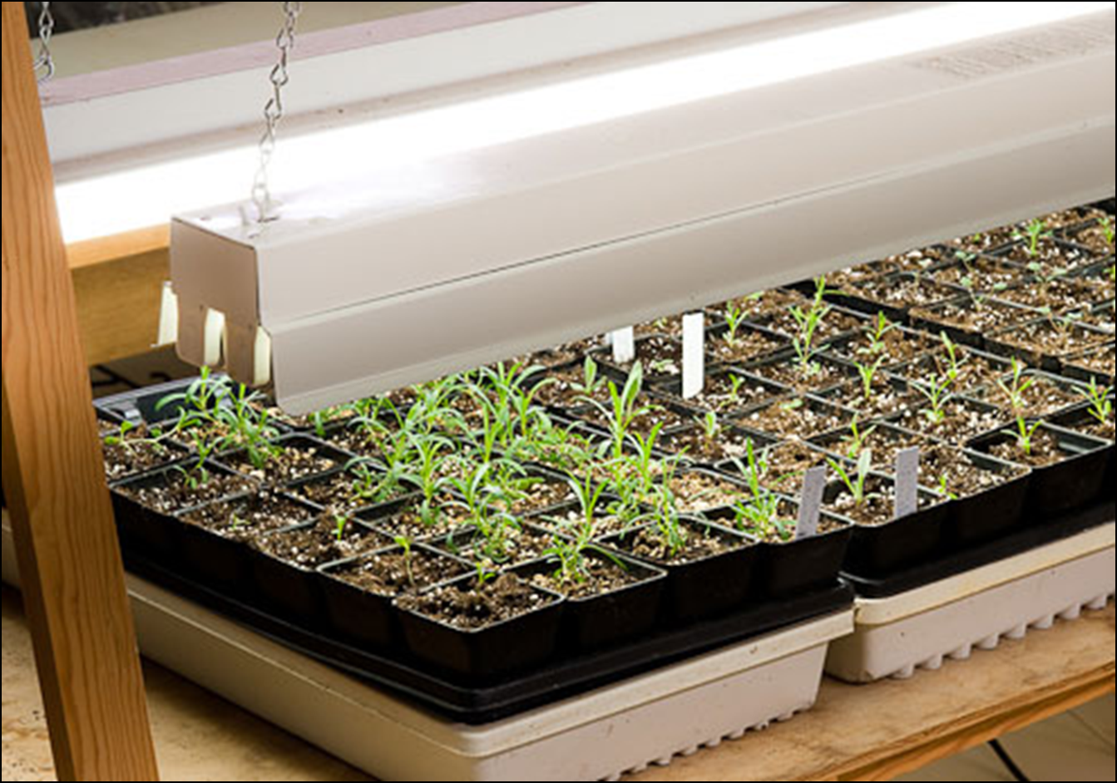
Lighting for Seedlings
Too far from lights
Notes:
Here’s an example of an artificial light set-up. Unfortunately the seedlings are a little too far away from the lights.

Slide 23
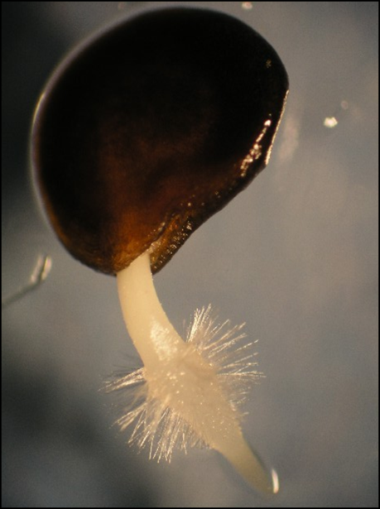
Germination
Barriers to Germination
Dormancy—may need a cold period to break dormancy
Scarification
  Soaking or scratching the seed
Stratification
  Exposing seed to moisture and specific temperatures degrades chemical inhibitors causing dormancy
Notes:
So we mentioned internal genetic traits earlier as having a role in germination. Some plant seeds need a cold period before they will germinate; it is just how they are programmed. Seeds like delphiniums, pansies and foxgloves will often benefit from a couple weeks in the refrigerator, though not the freezer before planting. Some seeds evolved to go through the gut of an animal so the seed coat gets softened and etched by stomach acid before it will hydrate properly. That process, called scarification can be mimicked by soaking the seed in water or scratching it lightly on fine-grained sandpaper. Has anyone used either of these methods? For which crops? How did it work? Some seeds, especially from woody plants like trees and shrubs have a more complicated internal dormancy to overcome. They may need for instance a cold moist period followed by a warm moist period to degrade chemical inhibitors and solften seed coats. There is a book called ‘The Reference Manual of Woody Plant Propagation’ by Michael Dirr that we have at the Extension office that covers techniques on germinating these type of seeds and you can call us if you have questions about those species.

Slide 24
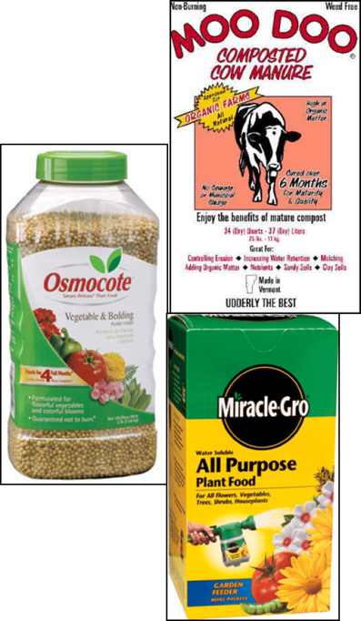
Fertilizer
Apply after seeds germinate and reach about ½-1 inch in height.
A half-strength dose of a water-soluble synthetic fertilizer such as 10-10-10 fertilizer OR a liquid organic product like fish emulsion or pasteurized compost tea can be used.
Use the synthetic fertilizer every two weeks; may need to apply the organic product more often depending on its analysis.
Notes:
Next we need to talk a little about fertilizer. You don’t want to apply fertilizers until the seedlings are about a half-inch to an inch tall. You don’t want to do it too soon because nitrogen can burn the young roots. Since you’ll be using seed-starting mix however, that has very little nutrient value for plants it is critical that you do fertilize at some point. You can use either traditional synthetic fertilizers or organic products—either will work, but the number of applications and amount of product will vary depending on the strength of the product you choose. Synthetic products are usually more concentrated and therefore will need dilution at first and fewer applications than organic products, which tend to be less concentrated.

Slide 25
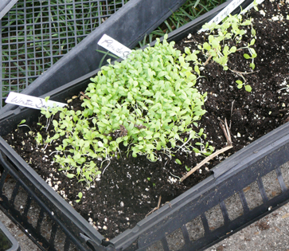
Thinning
Thinning out of seedlings can be done as soon as the first set of leaves comes out.
Thin to prevent physical and disease problems.
Snip off weaker plants at soil level with a small scissors so roots of the “keepers” are not damaged or disturbed.
Notes:
Thinning is one of those tasks we all hate to do. It is hard to remove growing seedlings that you worked hard to make healthy and happy, but if you want them to remain healthy and productive, they need to have room to grow. Too many plants crowded together, as in the photo will shade each other out and compete with each other for water and nutrients. Especially when seedlings are this close together, it’s important not to thin by yanking out the weaker plants as you will likely damage the ones you want to keep. Using a small sharp scissors to carefully snip out the seedlings you want to remove works really well; and the roots of the removed plants can act as a nutrient source as they decay for the remaining seedlings.

Slide 26
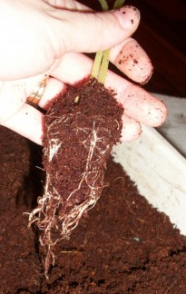
Transplanting
Move to larger container after thinning if needed
Handle seedling gently by cotyledons or leaves & support from below when transplanting, don’t pull the stem
Lift seedlings using a small flat tool (ex. plastic knife or popsicle stick)
Gently tease apart tangled plants/roots
Use a “dibble” (pencil or spoon) to make hole in the new media and press in gently, then water
crystalgh.hubpages.com
Notes:
Check your seedlings’ root systems periodically as the seedlings grow larger by looking at the bottom of the container for roots emerging through the drainage holes. If the plants seem to be getting root bound, they can be carefully transplanted into larger containers until they can go outside. Generally, you only want to go up a little larger in pot sizes and not transplant into vastly larger pots to avoid having the media remain too wet and having root rot result. Handle the plants gently by the leaves, being careful not to damage the stems. It is a good idea to support the plant roots from the base when lifting them rather than pulling them out by the stems.

Slide 27
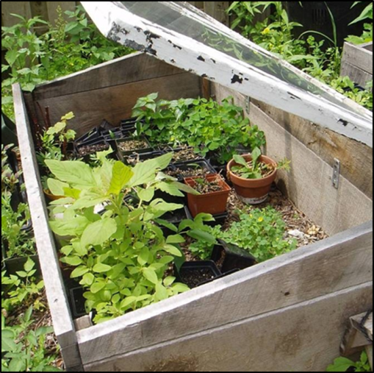
Hardening Off
After seedlings establish, move them to an airy, cooler location, with air temperatures of 55ºF to 60ºF night and 65ºF to 70º F day (in general).
Cold frames work well
https://store.extension.iastate.edu/ItemDetail.aspx?ProductID=4182
Hardening off alters the quality of plant growth through cuticle development so plants can handle rapid environmental changes.
Notes:
The next step is to begin the process of preparing the seedlings to face the outside world. This is called ‘hardening off’. Your seedlings have been pampered with optimal light, humidity and temperature and in order to get them to initiate a thicker cuticle layer that can protect them from our unpredictable weather, it’s time for some tough love. You want to gradually reduce the temperature at little and the humidity. You can start putting them outside a few hours at a time once the weather conditions cooperate, and gradually leave them out for longer periods of time. Don’t leave them out overnight at first. Ideally the process should occur over a couple of weeks, but depending on weather and the crop, a week may do just fine. Using a cold frame that retains some heat overnight is a great way to introduce your seedlings to the new world they will be growing in.

Slide 28
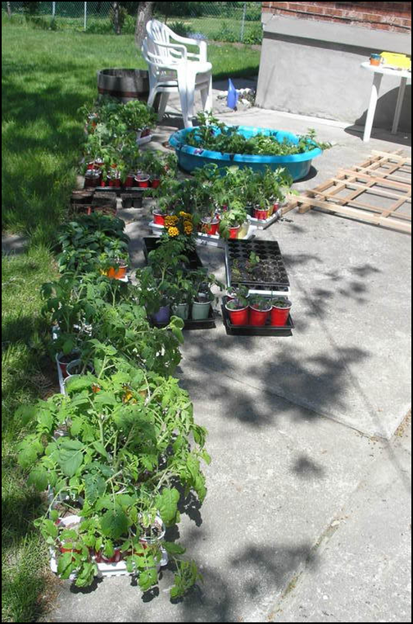
Hardening Off
Move seedlings to a sheltered location outdoors for a couple hours
Best in the early morning or early evening.
Start a couple of weeks before planting the seedlings in the garden.
Each day the plants stay outside longer and in sunnier, more exposed locations.
Notes:
This gardener probably has a wagon to lug plants in and out of the house during the hardening off process, or a lot of pots or blankets to cover up the tender plants if the temperature is going to go down a lot overnight. When you do finally plant outside, try to do it in the evening or on a cloudy day so the seedling will have some ‘recovery’ time before being hit with full sun and high temperatures.

Slide 29
Direct Seeding Outdoors
Direct seeding outside avoids transplant shock
Shorter season available than for seedlings started indoors, which means a later harvest
Less work but more risk with weather, insects, disease, erosion, squirrels and rabbits
Radish, leeks, carrots are best direct-seeded outside. Lettuce and spinach can be started inside or out. Tomatoes and peppers best started indoors
Peas, onion sets & potato ‘starts’ can go out on April 15, depending on weather in Madison
Beans go out mid-late May depending on weather in Madison
Notes:
Now that we’ve talked through the process for starting seeds indoors, it is time to briefly address some issues for direct-seeding outside. Make sure that the ground is warm enough before sowing seeds. Soil thermometers are inexpensive and can be purchased at many local garden centers. The soil should have been tilled prior to planting so it is fluffy and well-aerated. Raised beds should have some new media added and existing media turned with a shovel to loosen it. Direct seeding has some advantages—it is less work and since the plants are never transplanted, they never go through transplant shock. Many crops such as radishes, carrots, leeks and other root crops are best seeded directly outside as they do not transplant well. Some do well when seeded either indoors or outdoors. Usually peas, onion sets and potato starter tubers work best when planted directly outside. Usually these last three can go out in mid April, but soil temperatures must be at least 50°F for germination, so if it has been a cool spring, it is best to check first. The publications listed on the next slide will provide further information on various crops and their needs.

Slide 30
Seed Starting Resources
“The Seed-Starter’s Handbook”, Nancy Bubel
http://learningstore.uwex.edu/Vegetable-Garden-The-P518.aspx
“Ball Culture Guide: Encyclopedia of Seed Germination”, Jim Nau
“The Plant Propagator’s Bible”, Miranda Smith
Virginia Extension:
  http://pubs.ext.vt.edu/426/426-316/426-316.html
“Vegetable Gardening in the Midwest” C.E Voigt and J.S. Vandemark
Notes:
These are some of the resources we recommend that address seed starting and also vegetable gardening. The learningstore site also has many publications on other aspects of gardening, from trees to strawberries to insects and diseases, to mulching and soil conditioners , lawns, community gardens and information on pesky critters in the garden. We hope this presentation has been helpful for you and thank you for asking us to speak to you.

Slide 31
Thank You!
Lisa Johnson
Dane County UWEX Horticulture Educator
608-224-3715 johnson.lisa@countyofdane.com and Dane County UWEX
Master Gardener Volunteers
608-224-3721
Notes:
Are there any questions we can help with?

